Slide 1

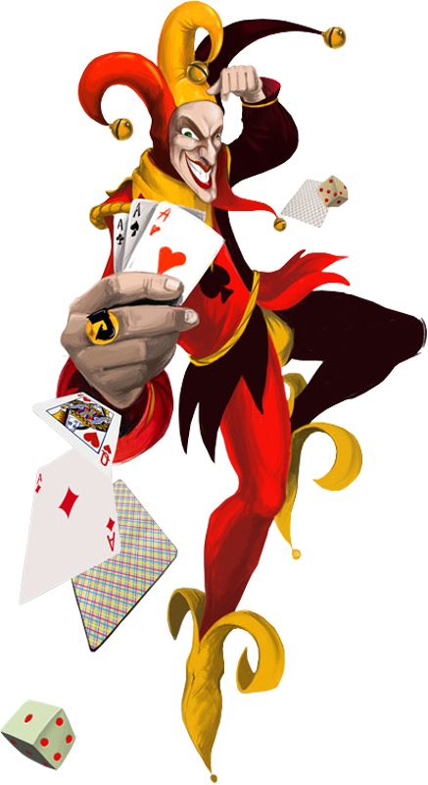
G
A
M
E
no more cards!
O
V
E
R
New Game?

