Slide 1
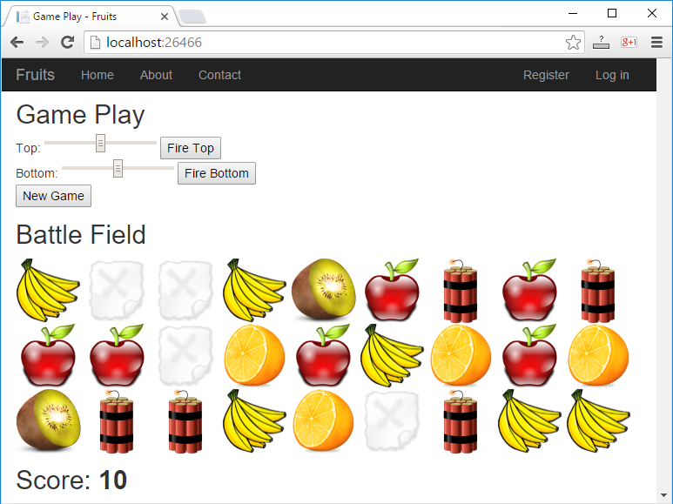
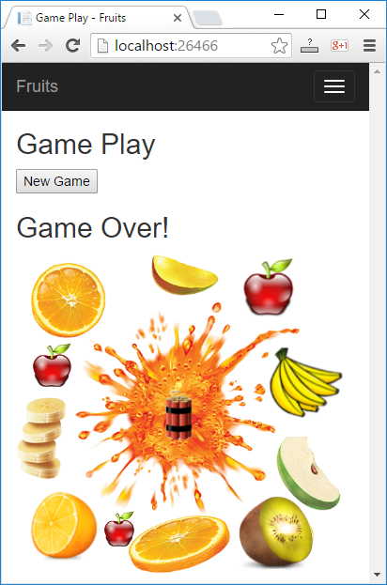
Web game with ASP.NET MVC
Shoot the fruits!

Slide 2
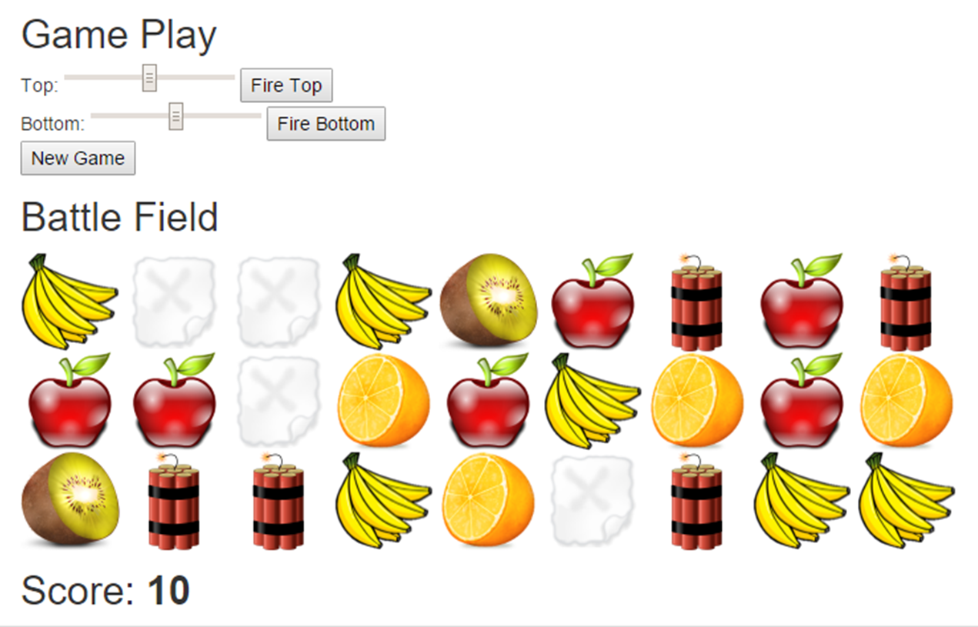
Web game “Shoot the fruits!"

Slide 3
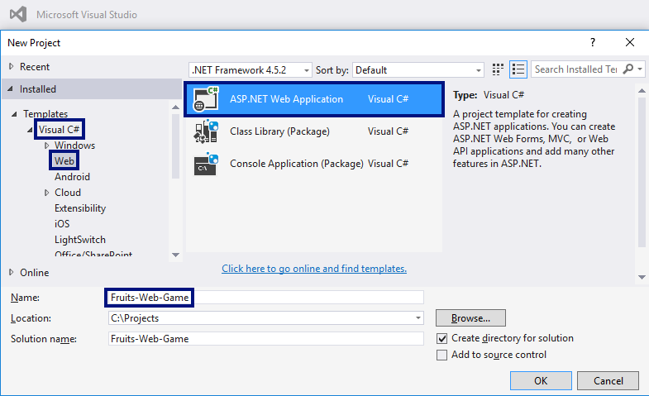
Create a web application in VS

Slide 4
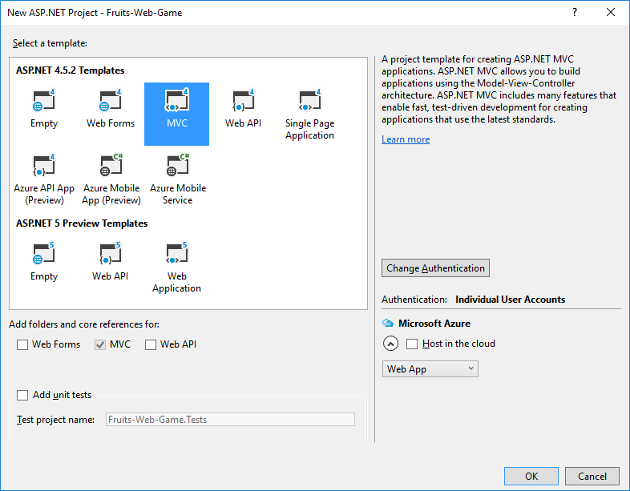
Type of web project → MVC

Slide 5
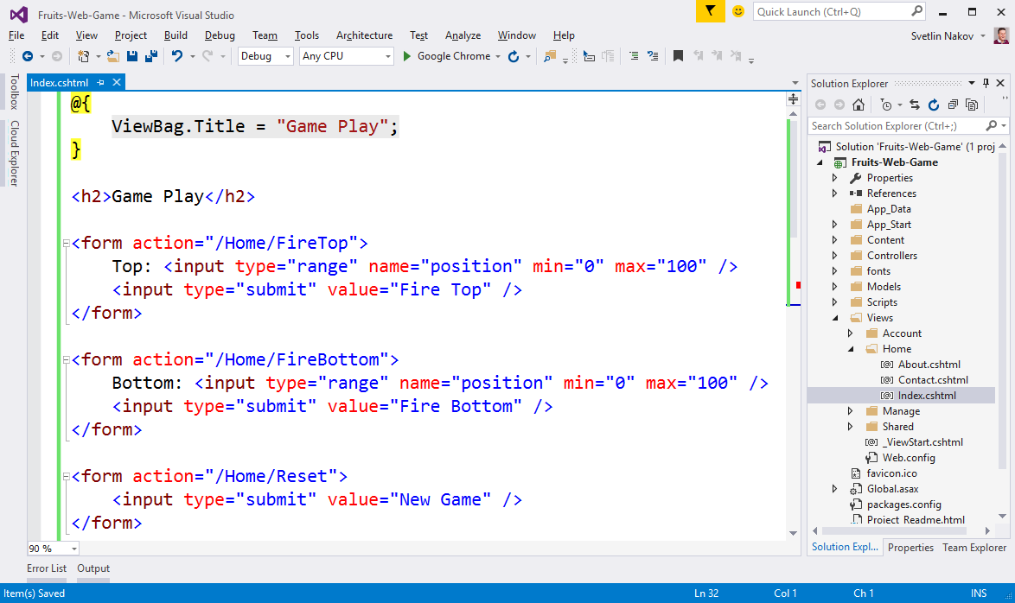
Create the controls in the game

Slide 6
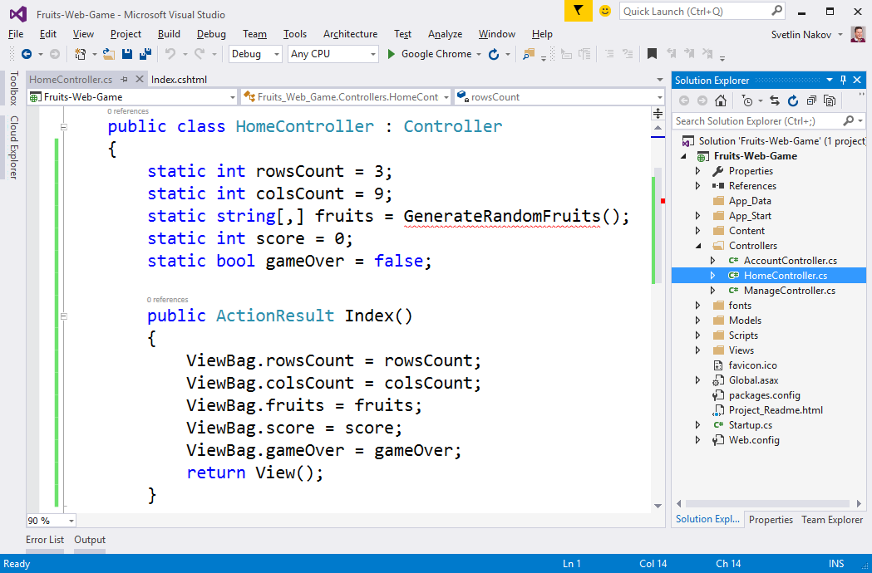
Prepare the fruits in the HomeController

Slide 7
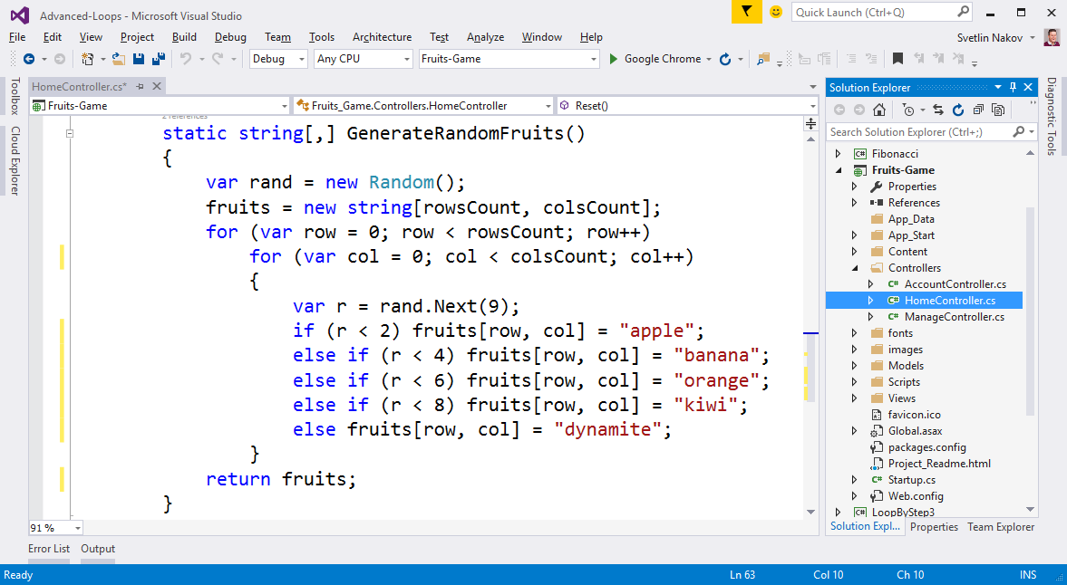
Generate random fruits

Slide 8
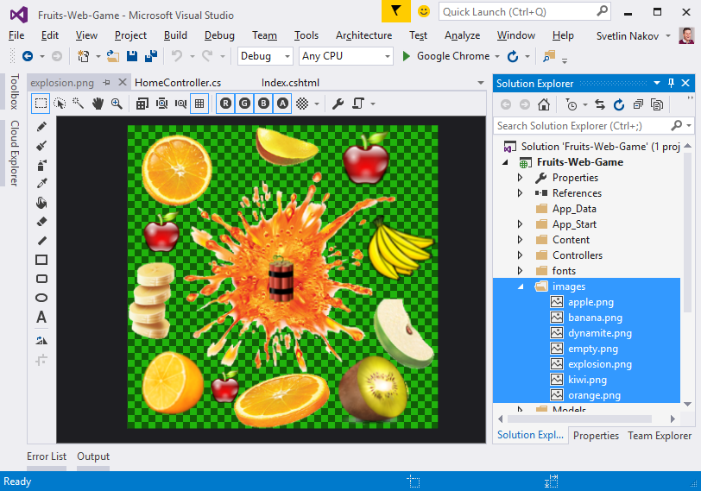
Add the images in the project

Slide 9
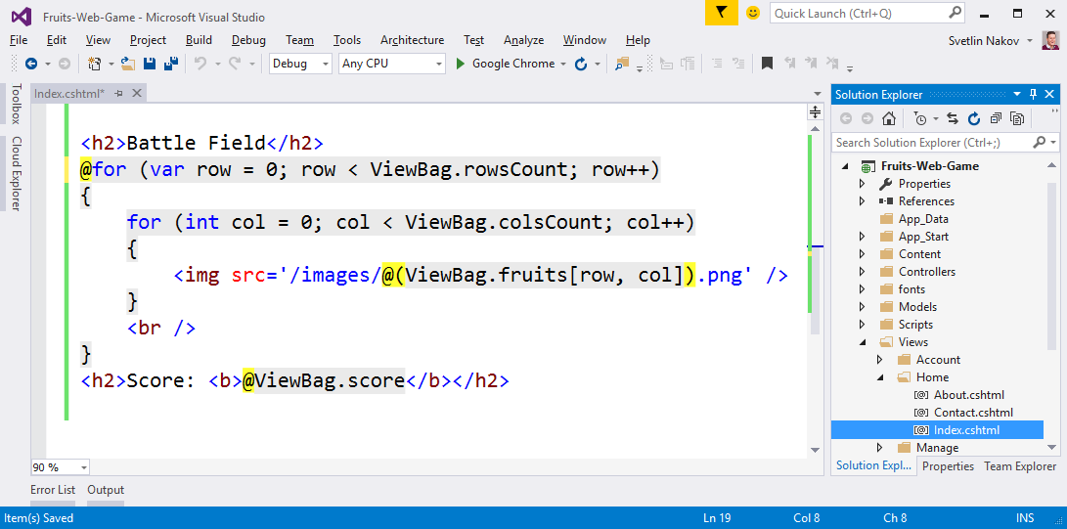
Draw the fruits in Index.cshtml

Slide 10
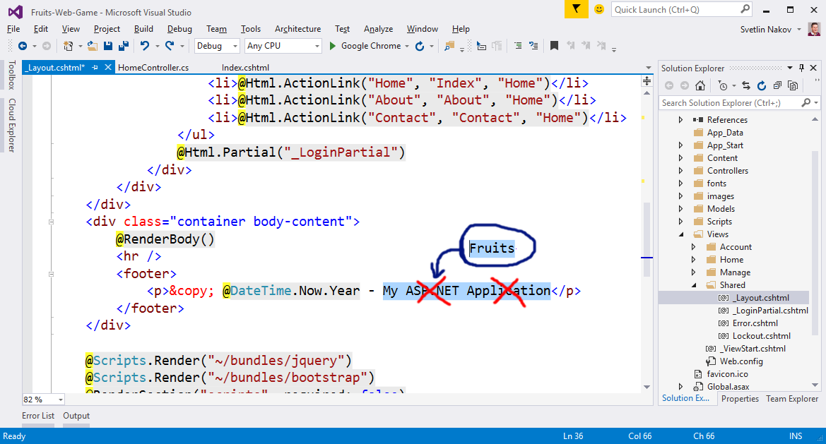
Setup the texts in _Layout.cshtml

Slide 11
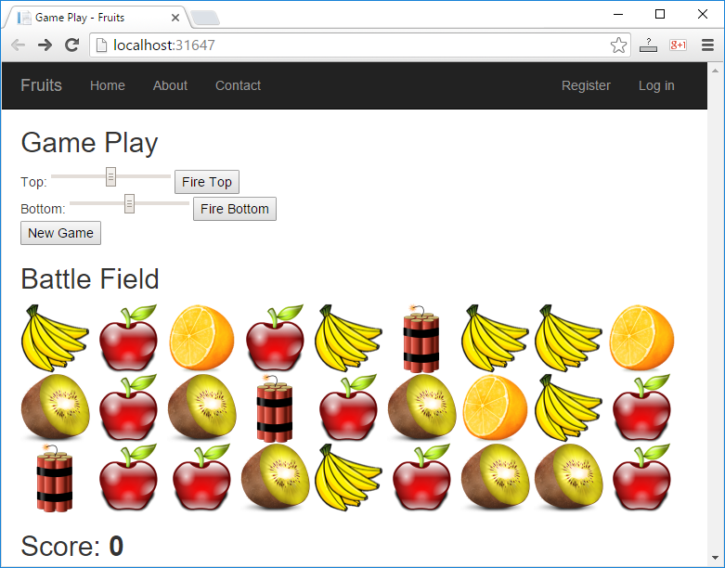
Start with [Ctrl+F5] and test

Slide 12
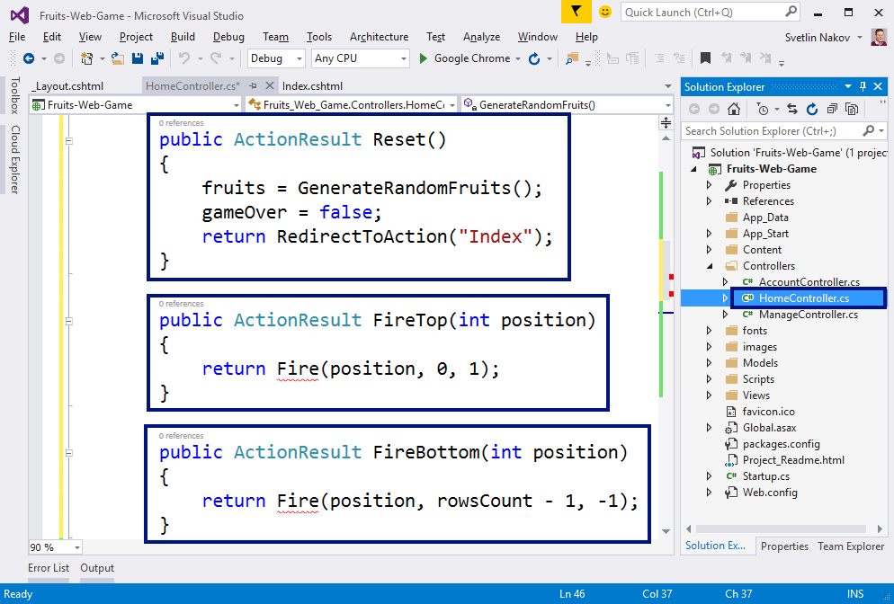
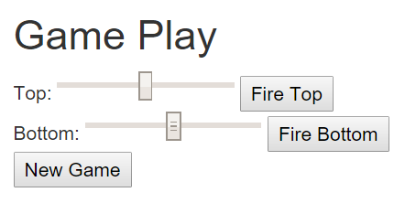
Add actions "Reset" and "Fire"

Slide 13
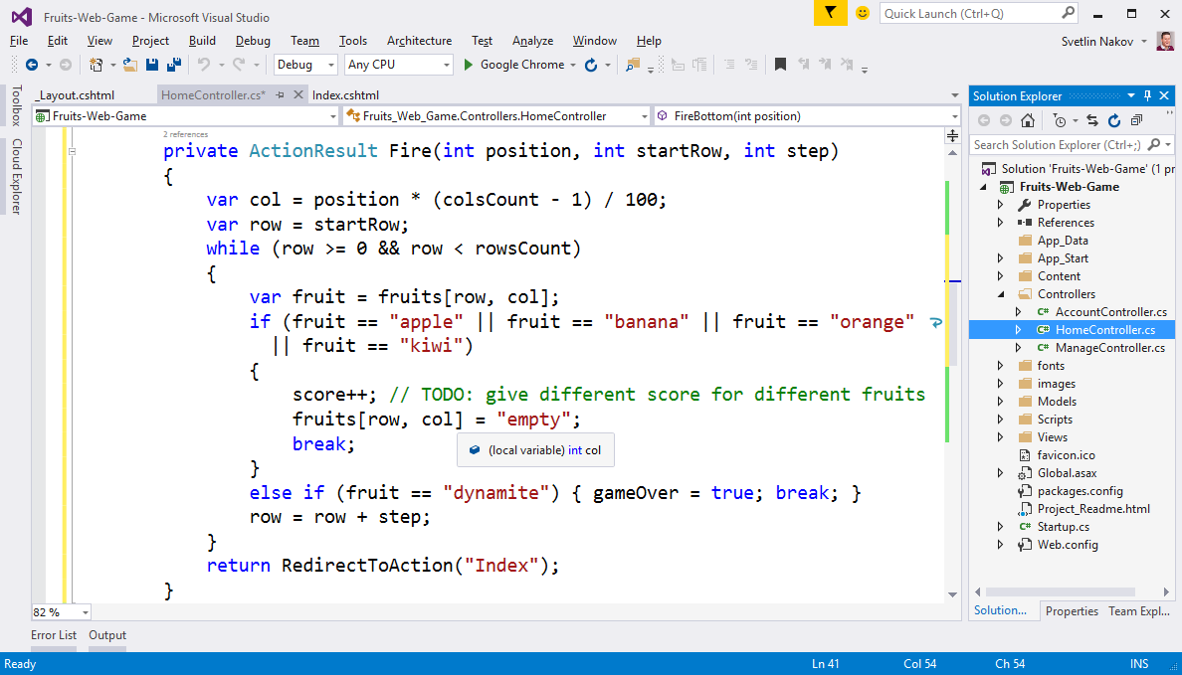
Implement "shooting"

Slide 14
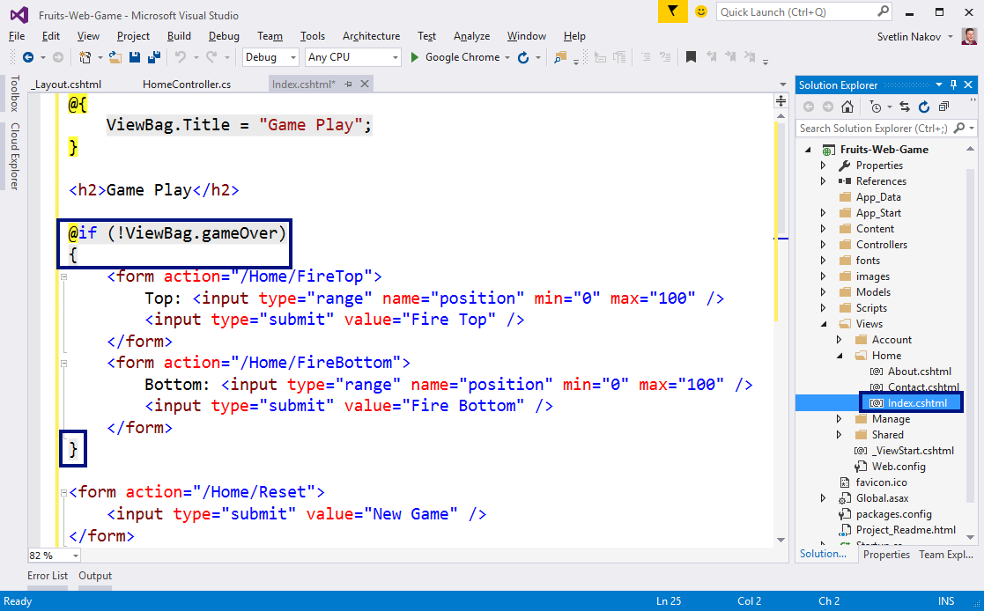
Implement "Game Over"

Slide 15
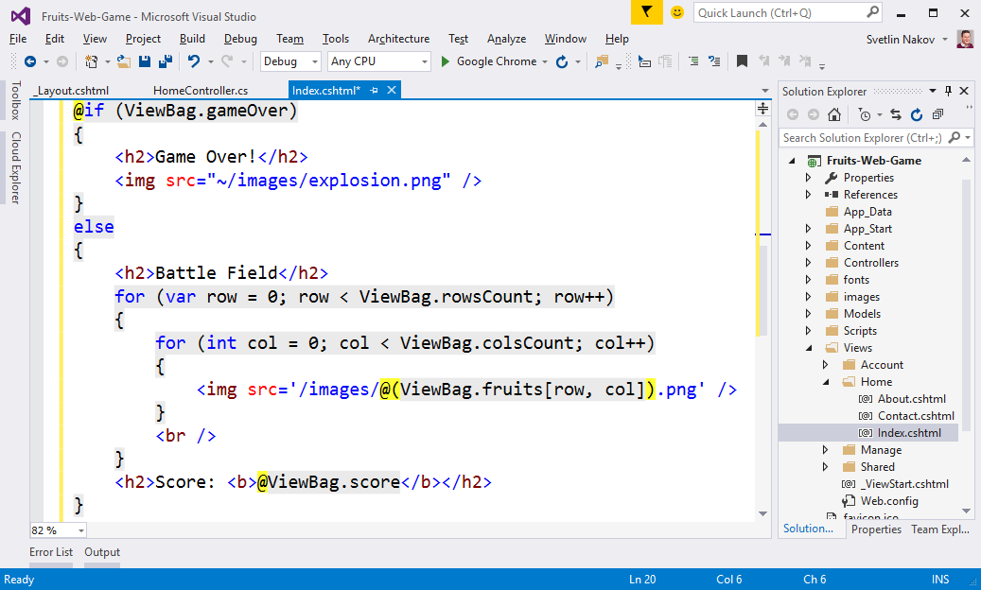
Implement "Game Over" (2)

Slide 16
Start with [Ctrl+F5] and test

Slide 17

Web game with ASP.NET MVC
Try it yourself

