Slide 1
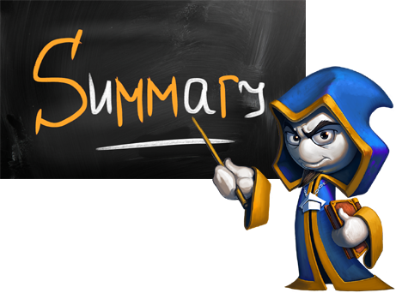
What did we learn today?

Slide 2

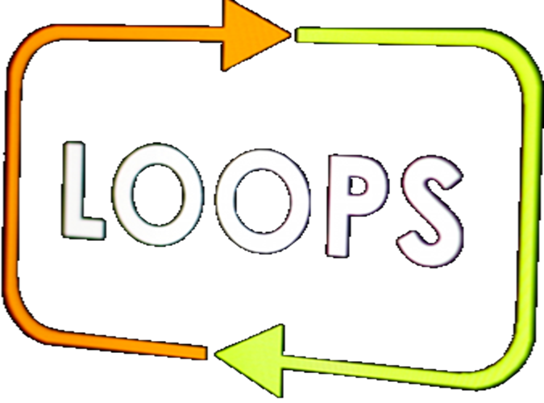
What did we learn today?
We can use for-loops with a step:
while / do-while loops iterate while a given condition is met:
for (var i = 1; i <= n; i+=3)
Console.WriteLine(i);
int num = 1;
while (num <= n)
Console.WriteLine(num++);

Slide 3

What did we learn today?
Do the exercises!

