Slide 1
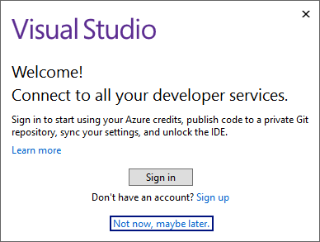
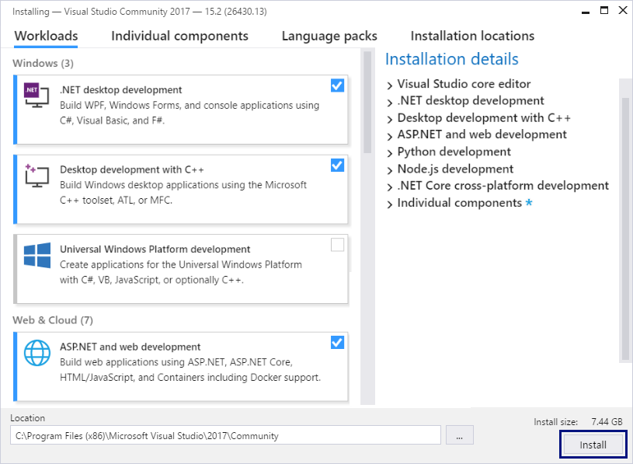
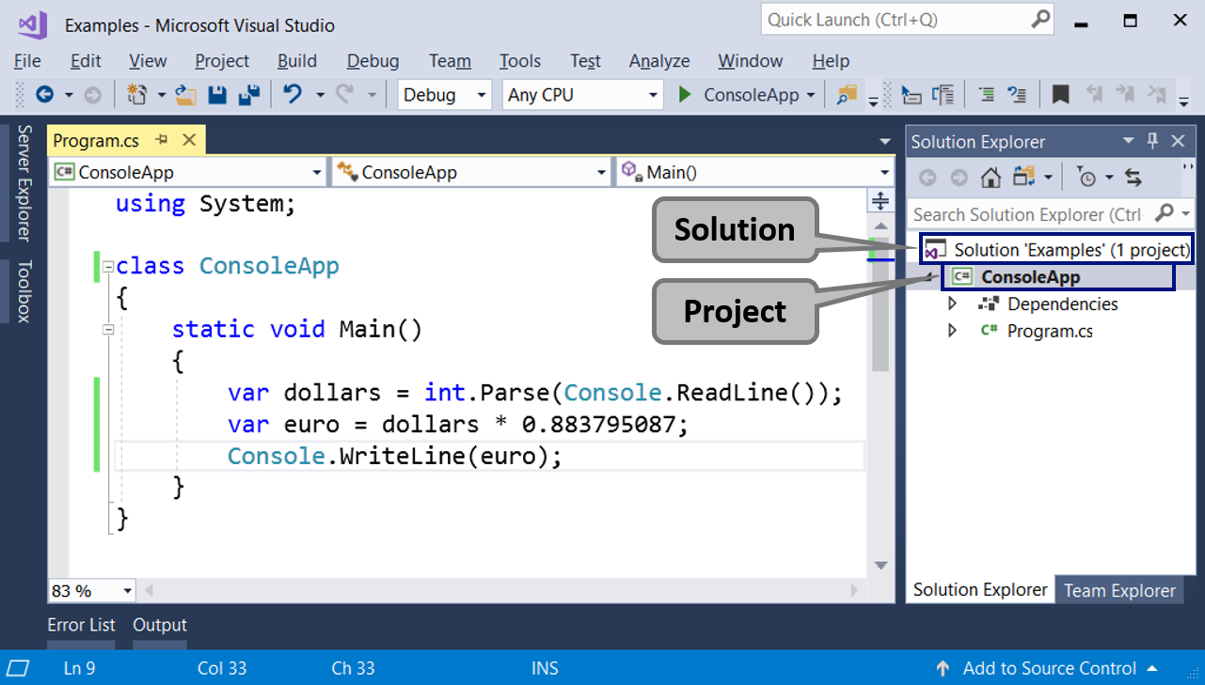
Installing and Running Visual Studio

Slide 2
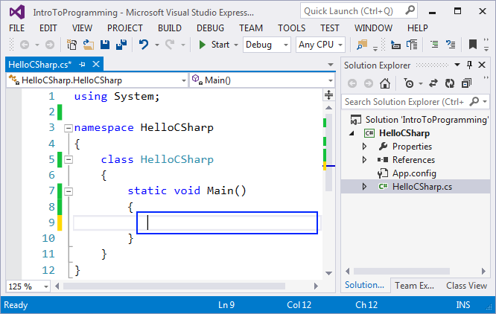
Integrated Development Environments (IDE)
In order to program, we need an IDE
For C# →
Visual Studio (for Windows)
Visual Studio / Raider (for macOS)
Visual Studio Code / Raider (for Linux)
For Java → IntelliJ IDEA / Eclipse
For Python → PyCharm / Eclipse / Visual Studio Code
For JavaScript → WebStorm / Visual Studio Code

Slide 3
Development Environments: Desktop and Online
Install Microsoft Visual Studio Community
https://visualstudio.com/products/visual-studio-community-vs
You can use an older version, but it is not recommended
Alternative IDE (online)
C#: https://dotnetfiddle.net
Java: https://compilejava.net
Python: https://repl.it
JavaScript: directly use the browser console (press [F12] key)

Slide 4
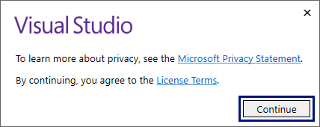
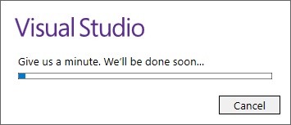
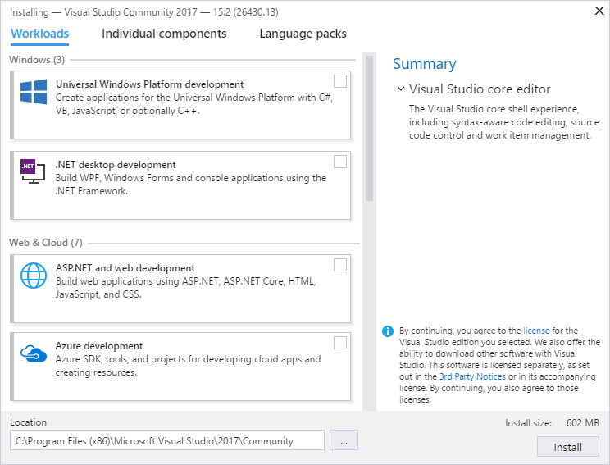
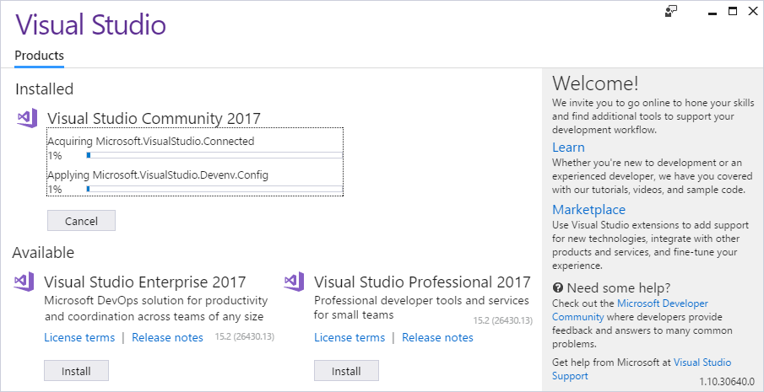
Installing Visual Studio
https://visualstudio.microsoft.com

Slide 5
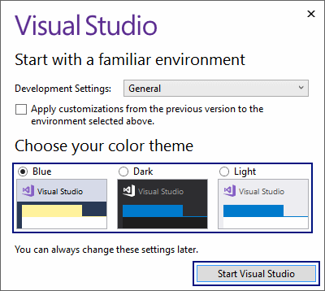
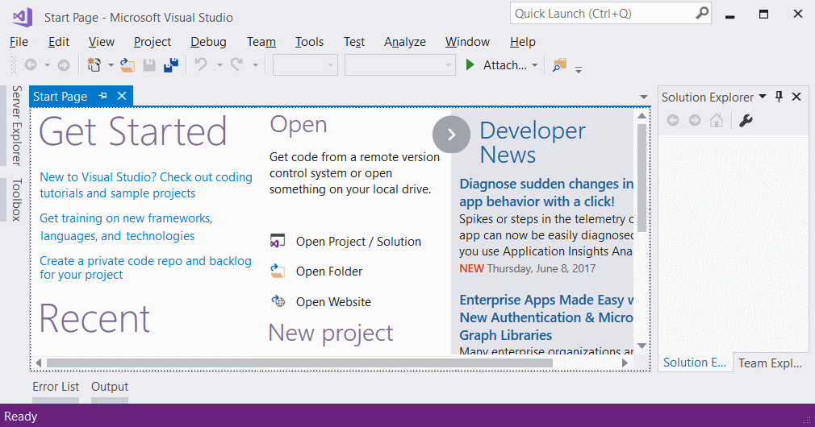
Running Visual Studio

Slide 6
Solutions and Projects in Visual Studio

Slide 7

Installing and Running Visual Studio
Try Yourself!

