Slide 1
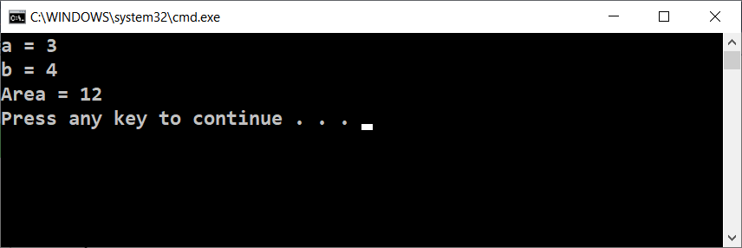
The System Console

Slide 2
The System Console
The system console is a window used to read and write text data (text lines)
Read text lines
Print text lines

Slide 3

The System Console
Do your research!

