Slide 1
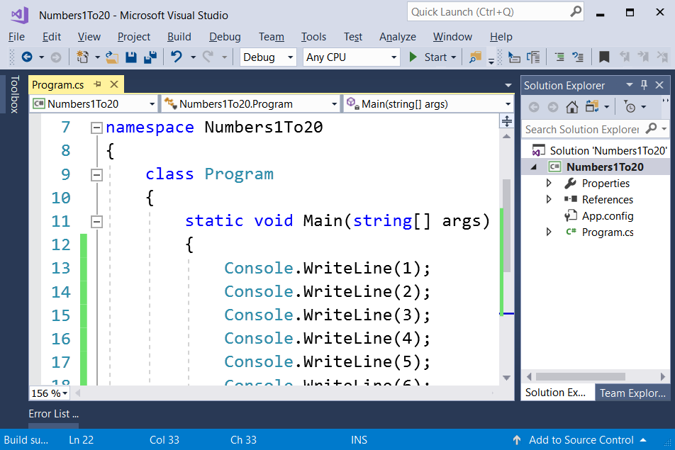
Problem "Numbers 1 to 20"

Slide 2
Problem "Numbers 1 to 20"
Write a C# console program that prints the numbers from 1 to 20 on separate lines on the console:
1
2
3
…
20
Hints:
Use Console.WriteLine(…) many times, number by number
Or search in Internet about "for loops"

Slide 3

Problem "Numbers 1 to 20"
Solve It Yourself!

