Slide 1
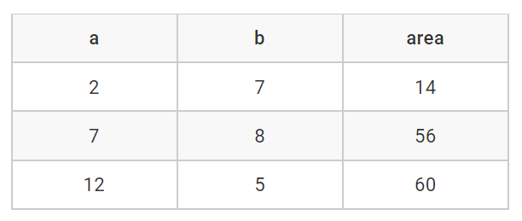
Problem "Rectangle Area"

Slide 2
Problem "Rectangle Area"
Read from the console the sides of rectangle: numbers a and b
Calculate and prints the area of the rectangle
Examples:
2
7
14
Hints: to read an integer from the console use:
var a = decimal.Parse(Console.ReadLine());
7
8
56

Slide 3

Problem "Rectangle Area"
Solve It Yourself!

