Slide 1
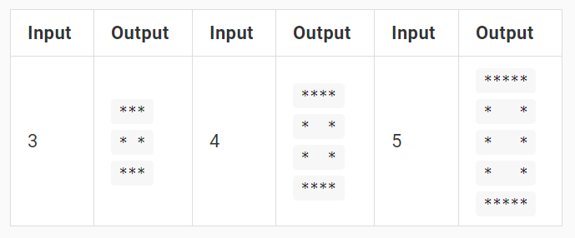
Problem "Square of Stars"

Slide 2
Problem "Square of Stars"
Read from the console a number n
Print a square of stars of size n * n like it is shown below:
*****
* *
* *
* *
*****
Hints:
Print n stars: "***…*"
Print n times "*" + n-2 spaces + "*"
Print n stars: "***…*"
You should loops obligatory!
5

Slide 3

Problem "Square of Stars"
Solve It Yourself!

