Slide 1
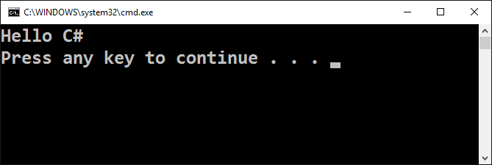
Writing Our First Console Application in Visual Studio

Slide 2
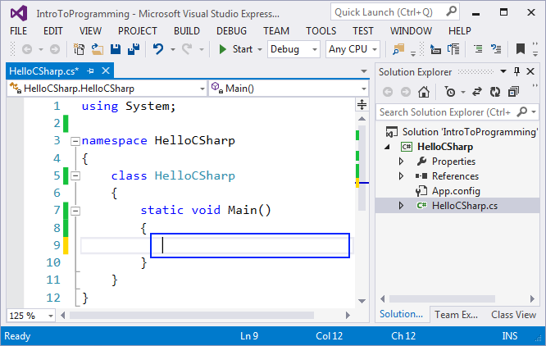
Integrated Development Environment (IDE)
In order to program, we need an IDE
For C# →
Visual Studio (for Windows)
Visual Studio / Raider (for macOS)
Visual Studio Code / Raider (for Linux)
For Java → IntelliJ IDEA / Eclipse
For Python → PyCharm / Eclipse / Visual Studio Code
For JavaScript → WebStorm / Visual Studio Code

Slide 3
Integrated Development Environment (IDE)
Install Microsoft Visual Studio Community
https://visualstudio.com/products/visual-studio-community-vs
You can use an older version, but it is not recommended
Alternative IDE (online)
C#: https://dotnetfiddle.net
Java: https://compilejava.net
Python: https://repl.it
JavaScript: directly use the browser console (press [F12] key)

Slide 4
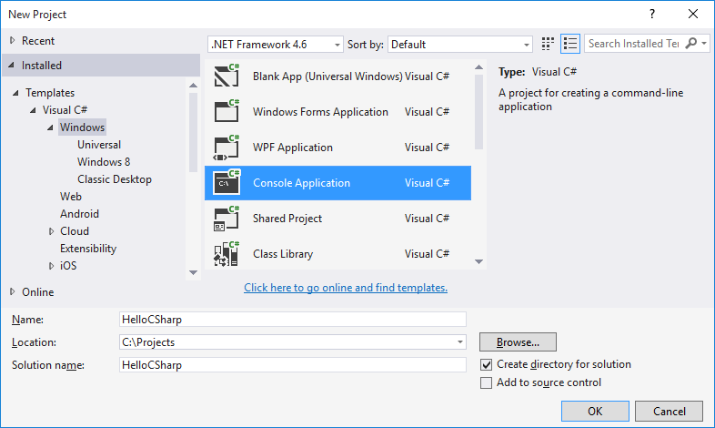
Creating a Console Application in Visual Studio
Start Visual Studio (VS)
New Console Application– [File]→ [New] → [Project] → [Visual C#] → [Windows] → [Console Application]

Slide 5
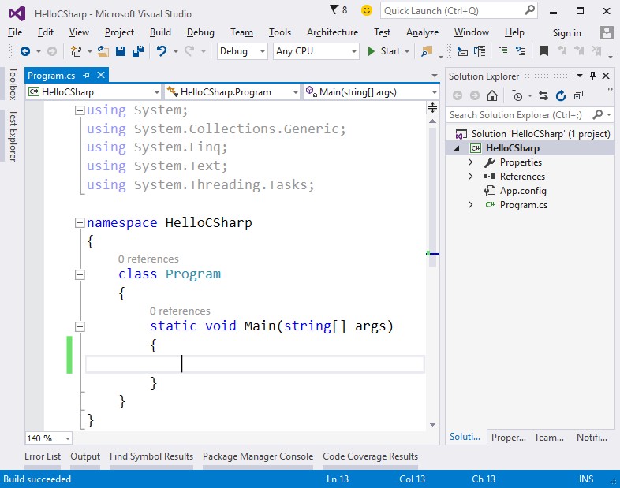
Writing Programming Code
The source code of the program is written in Main(string[] args)
Between the opening and closing curly brackets { }
Press [Enter] after the opening bracket {
The code of the program is written with indentation

Slide 6
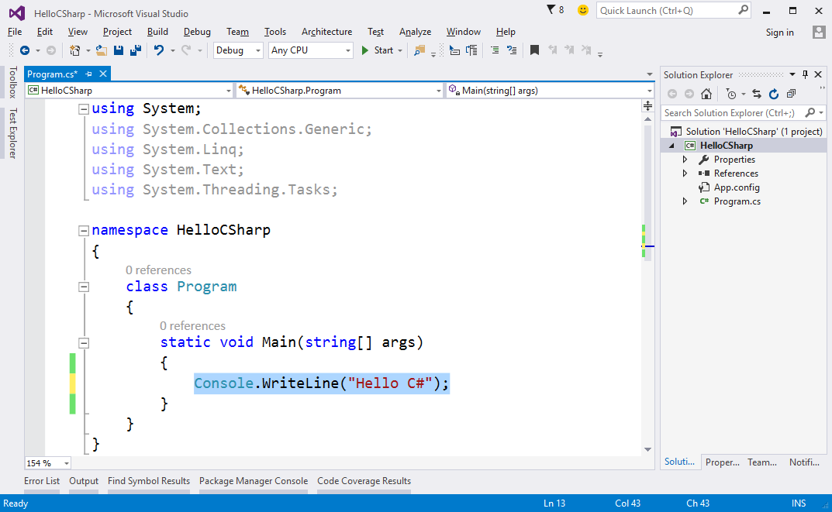
Writing Programming Code (2)
Write the following:
Console.WriteLine("Hello C#");

Slide 7
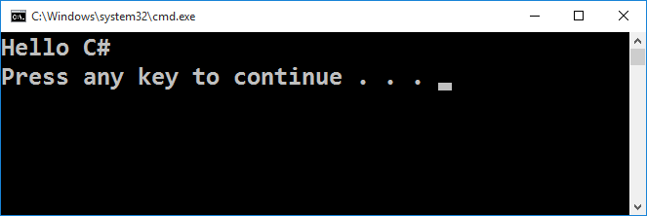
Starting the Program
To start the program, press [Ctrl + F5]
If there are no errors, the program will launch
The result will appear in the console (terminal window):

Slide 8
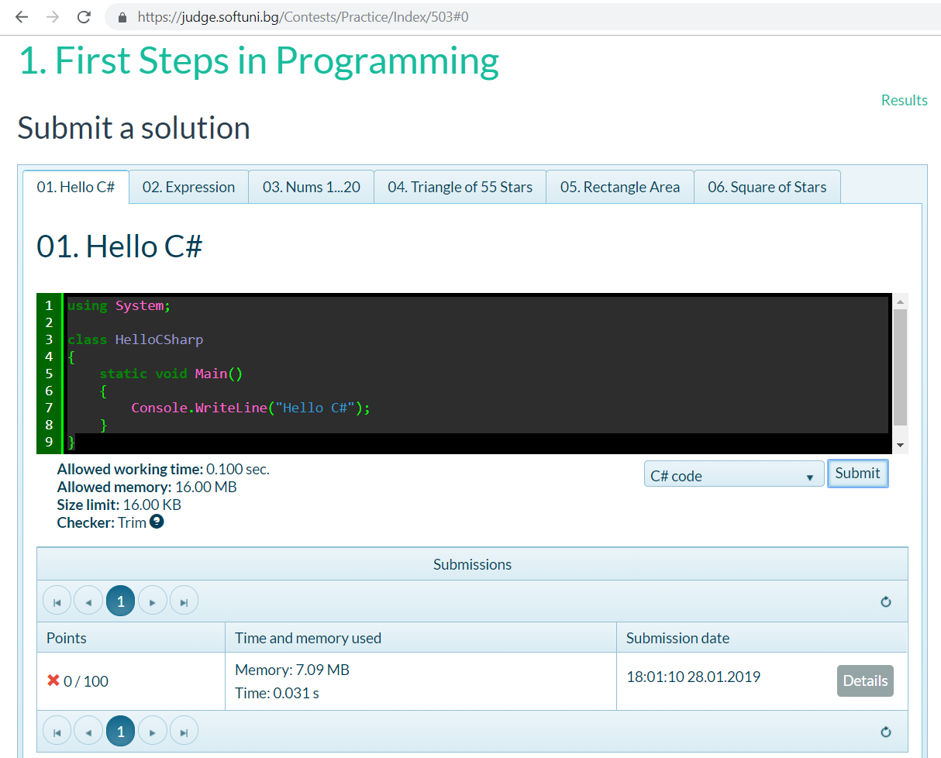
Testing the Program in Judge System
Test the code in the online Judge system:
https://judge.softuni.bg/Contests/503/1-First-Steps-in-Programming

Slide 9






Typical Mistakes in C# Program
Writing outside the Main() method:
Wrong capital/lower casing:
Missing ; at the end of every command
Missing quote " or bracket ( or )

Slide 10

First Console Application in Visual Studio
Try It Yourself!

