Slide 1
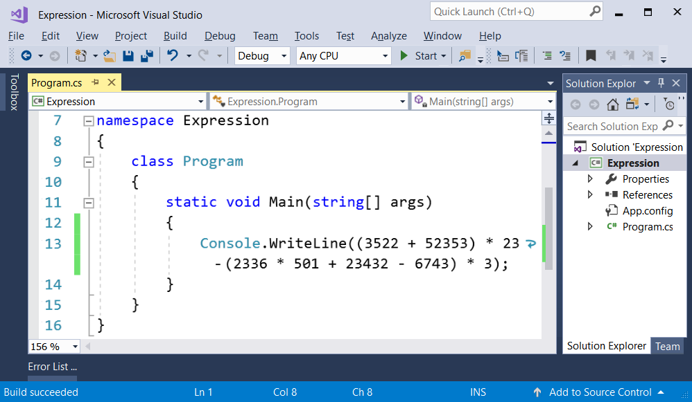
Problem "Expression"

Slide 2
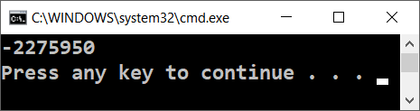
Problem "Expression"
Write a console-based C# console program that calculates and prints the value of the following numerical expression:
Note: it is not allowed to previously calculate the value (for example with Windows Calculator)
Expected output:
Hints: use Console.WriteLine(…)
(3522 + 52353) * 23 - (2336 * 501 + 23432 - 6743) * 3

Slide 3

Problem "Expression"
Solve It Yourself!

