Slide 1
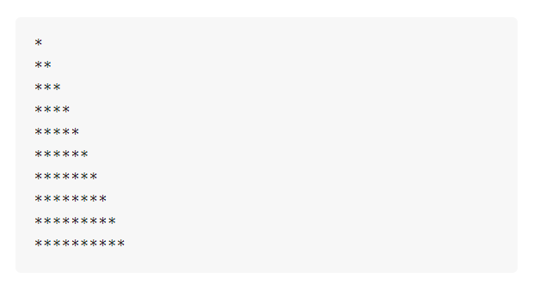
Problem "Triangle of 55 Stars"

Slide 2
Problem "Triangle of 55 Stars"
Write a C# console program that prints a triangle made of 55 stars on 10 lines:
*
**
***
****
*****
******
*******
********
*********
**********
Hints:
Use Console.WriteLine(…) many times, number by number
Or search in Internet about "for loops"

Slide 3

Problem "Triangle of 55 Stars"
Solve It Yourself!

