Slide 1


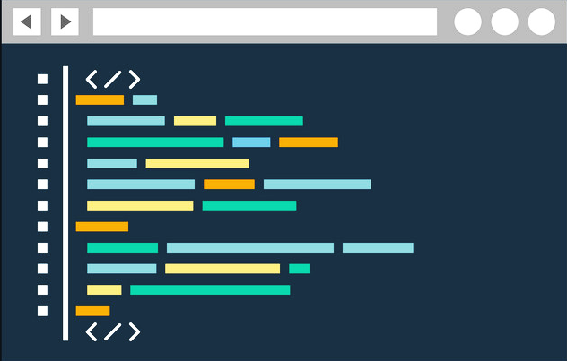
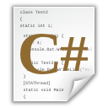
What Did We Learn Today?

Slide 2
What Did We Learn Today?
Programming means to give commands for the computer
A computer program is a sequence of commands
We use a programming language (like C#) + IDE (like Visual Studio)
In C#, commands are written in Main(…)
We print with Console.WriteLine(…), and start with [Ctrl+F5]
static void Main()
{
Console.WriteLine("Hello");
}

Slide 3

What Did We Learn Today?
Do the Exercises!

