Slide 1
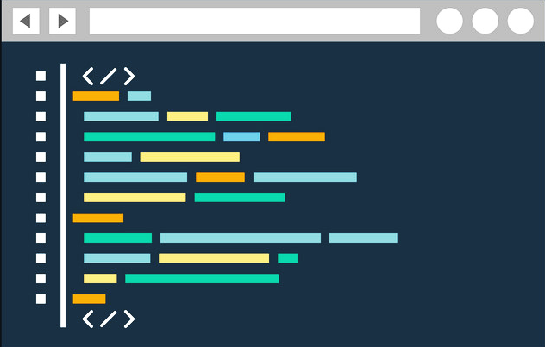
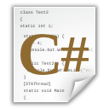

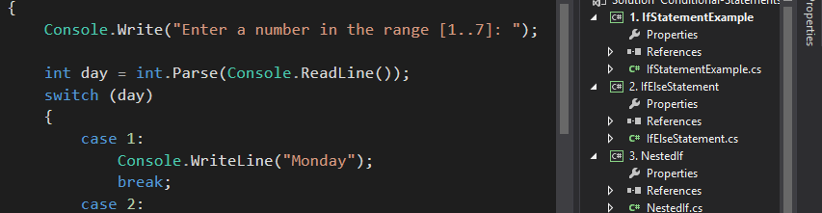
Programming Basics with C#
Welcome to Our Free Coding Video Training + Book + Platform
Programming Basics
Dr. Svetlin Nakov
Co-Founder, Chief Training, Innovation and Inspiration
Software University / SoftUni
https://softuni.org

Slide 2

Table of Contents
Course Objectives and Scope
Target Audience: Absolute Beginners
Why Did We Choose C#?
Learning Resources: Videos + Book + Judge
Exercises and Exams
SoftUni and the SoftUni Judge System
How to Become a Software Developer?
Trainers and Contributors

Slide 3


Course Objectives and Scope
The "Programming Basics with C#" training course
Teaches the very basic coding skills with C#
Writing simple commands and programs, using IDE
Reading and printing numbers and text on the console
Checking conditions (if-else, switch-case statements)
Loops: repeating code blocks (for, while, do-while)
Methods: reusable blocks of code (with parameters)
A starting point for learning software development

Slide 4


Target Audience
Absolute beginners
No previous knowledge or skills are required
Anyone could join and start coding

Slide 5
Why Did We Choose C#?
C# is modern programming language
Simple, developer-friendly
Powerful and multi-purpose
Object-oriented, functional and procedural programming
Very suitable for beginners
Big developer community
In the top 5 of the most popular languages in the industry

Slide 6
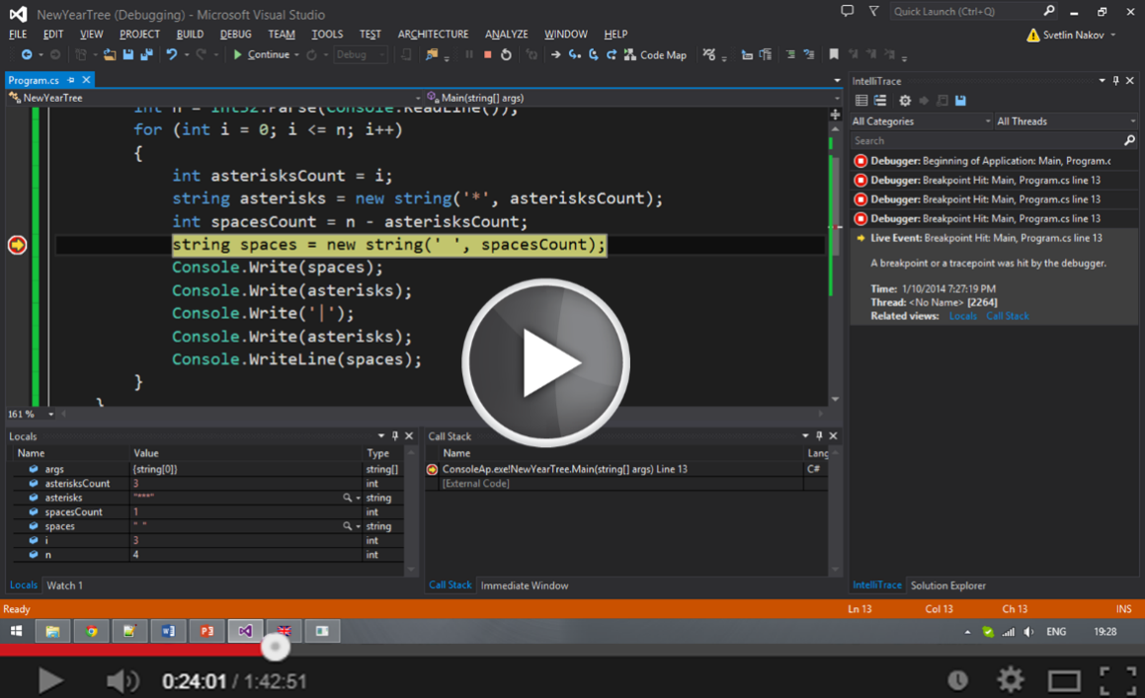

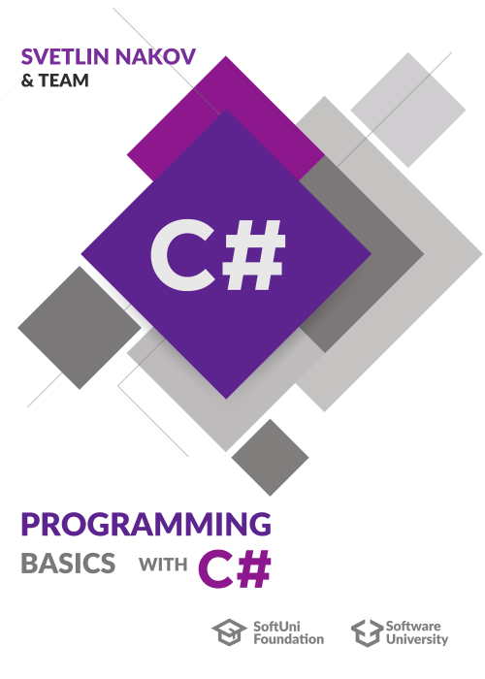


Learning Resources
Free video lessons
Trainers explain, demonstrate, write code, solve exercises
Free text-book
Well explained concepts
https://csharp-book.softuni.org
Online judge system
Automated evaluation for the exercises
https://judge.softuni.bg
Presentation slides (for teachers)

Slide 7
Exercises and Exams
Exercises are extremely important
You can't learning programming by watching videos
Programming is learned by practice: a lot of coding every day!
Each lesson is followed by:
10-20 exercises – solve them to learn the concepts from the lesson in practice
5-6 exam problems – solve them to prepare for a practical exam
Practical exam preparations: prepare for the exam at SoftUni

Slide 8

Programming Basics with C#
Go Ahead!

