Slide 1
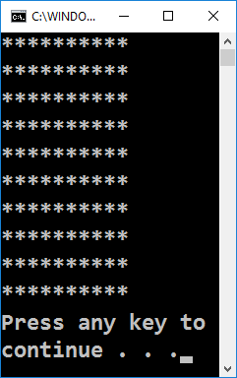
Rectangle of 10 x 10 Stars

Slide 2
Rectangle of 10 x 10 Stars
Draw a rectangle of 10 x 10 stars on the terminal:
How does the example work?
Draws a string 10 times, which consists of 10 asterisks
for (var i = 1; i <= 10; i++)
{
Console.WriteLine(new string('*', 10));
}
Testing the solution: https://judge.softuni.bg/Contests/Practice/Index/155#0

Slide 3
Rectangle of 10 x 10 Stars – Nested Loops
Draw a rectangle of 10 x 10 stars on the terminal:
for (var row = 1; row <= 10; row++)
{
for (var col = 1; col <= 10; col++)
Console.Write("*");
Console.WriteLine();
}
Testing the solution: https://judge.softuni.bg/Contests/Practice/Index/155#0

Slide 4

Rectangle of 10 x 10 Stars
Try it yourself

