Slide 1


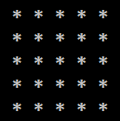
Rectangle of N x N Stars

Slide 2
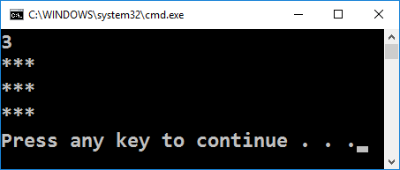
Rectangle of N x N Stars
Draw a rectangle of N x N stars:
int n = int.Parse(Console.ReadLine());
for (var i = 1; i <= n; i++)
{
Console.WriteLine(
new string('*', n));
}
Testing the solution: https://judge.softuni.bg/Contests/Practice/Index/155#1

Slide 3
Rectangle of 10 x 10 Stars – Nested Loops
Draw a rectangle of 10 x 10 stars on the terminal:
int n = int.Parse(Console.ReadLine());
for (var row = 1; row <= n; row++)
{
for (var col = 1; col <= n; col++)
Console.Write("*");
Console.WriteLine();
}
Testing the solution: https://judge.softuni.bg/Contests/Practice/Index/155#1

Slide 4

Rectangle of N x N Stars
Try it yourself

