Slide 1



Computer Programs – Concepts

Slide 2
What Does It Mean "To Program"?
To "program" means to give commands to the computer, e.g.
The commands are lined up one after another
That’s how they form a "computer program“
A computer program is a sequence of commands
A sequence of commands that achieve a result we call an algorithm
Programs are written in a programming language
E.g. C#, Java, JavaScript, Python, PHP, C, C++, Swift, Go, …
Console.WriteLine("Welcome to coding");
Run

Slide 3
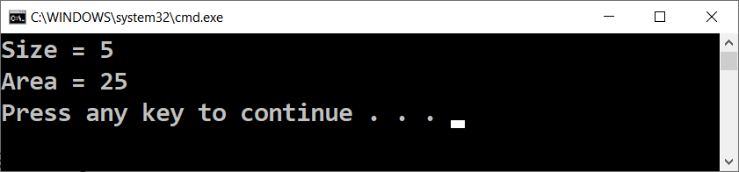
Computer Programs – Example
Sample C# program (sequence of C# commands):
var size = 5;
Console.WriteLine("Size = " + size);
Console.WriteLine("Area = " + size * size);
Run

Slide 4
Computer Programs – Example
Sample complete C# program (class + method + commands):
using System;
class SquareArea
{
public static void Main()
{
var size = 5;
Console.WriteLine("Size = " + size);
Console.WriteLine("Area = " + size * size);
}
}
Run

Slide 5
Programming Languages, Compilers, Interpreters
The programming language defines a set of rules (syntax)
Languages are either compiled (like C#, C++) or interpreted (like JavaScript and Python)
The compiler translates programming code to machine code
During the compilation, it finds syntax errors in the code
The interpreter executes the source code line by line
It finds syntax errors during runtime

Slide 6
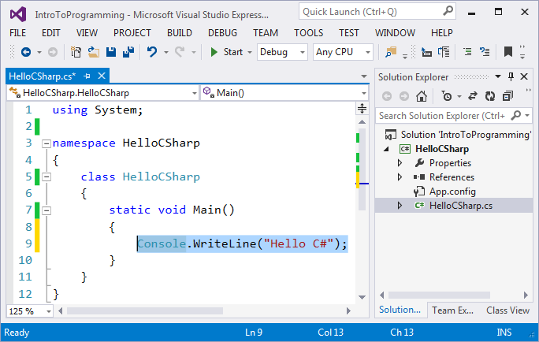
Integrated Development Environments (IDE)
Integrated Development Environments (IDE) helps the process of writing software
IDEs saves time and eases the process of coding
For programming in C#, we use Visual Studio
Alternatives are MonoDevelop and Rider

Slide 7

What Does It Mean "To Program"?
Try Coding!

