Slide 1


How to Become a Software Developer?
The Knowledge and Skills Required: Coding, Algorithmic Thinking, Computer Science and Software Engineering, Languages and Software Technologies
Programming Basics
Dr. Svetlin Nakov
Co-Founder, Chief Training, Innovation and Inspiration
Software University / SoftUni
https://softuni.org

Slide 2

The Skills of The Software Developer
4 main groups of skills:
Coding skills – 20%
Algorithmic thinking – 30%
Computer science and software engineering – 25%
Programming languages and technologies – 25%

Slide 3


Skill #1 – Coding (20%)
The skill to write code
Using variables, conditional statements, loops
Using functions, objects, methods
Working with data: arrays, lists, dictionaries and other structures
Takes 3-6 months
The programming language doesn't matter!

Slide 4

Skill #2 – Algorithmic Thinking (30%)
Algorithmic thinking (engineering, mathematical thinking)
Ability to analyze problems and propose solutions
Break-down the problem into steps (algorithm)
How to develop an algorithmic thinking?
Solve 1000+ problems in programming
Takes 6-12 months
The programming language doesn't matter!

Slide 5

Skill #3 – Fundamentals of Software Development (25%)
Computer science and software engineering concepts
Object-oriented programming (OOP) and modeling
Functional programming (FP)
Asynchronous programming and parallel execution
Databases, SQL, databases servers (e.g. MySQL, MongoDB)
Internet technologies (HTTP, JS front-end, DOM, AJAX, REST, …)
Software engineering (source control, dev processes, architectures)
Takes 6-12 months
The programming language doesn't matter!

Slide 6
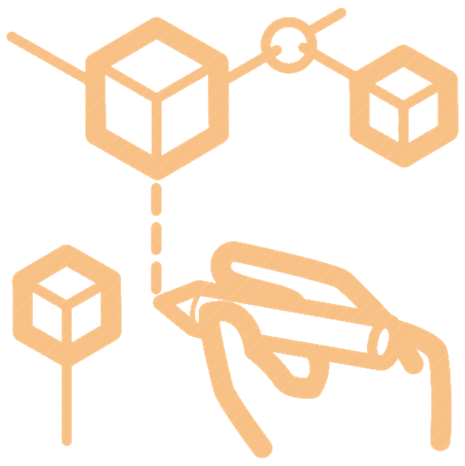
Skill #4 – Languages and Software Technologies (25%)
The programming language and software technologies
Only 25% of the skills of the software developers!
Programming languages and technologies come always in a combination (technologies stack)
Sample minimum for Junior .NET Developer:
Coding skills, C# + .NET Core + Visual Studio + databases + SQL Server + SQL + Entity Framework + ASP.NET MVC + HTML + CSS + JavaScript + AJAX + REST + XML + OOP + FP + algorithmic thinking + Git + software engineering + English languages + personal skills
Takes 6-12 months

Slide 7

How to Become a Software Developer?
Go Ahead!

