Slide 1
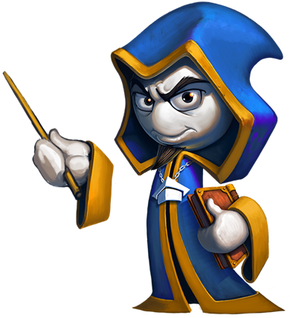
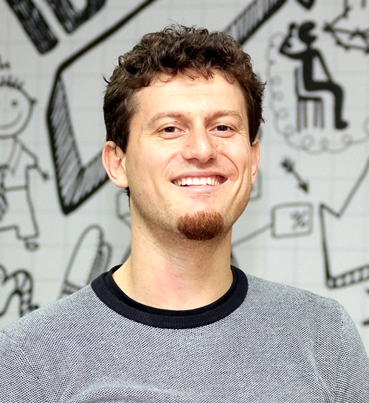
Trainers and Contributors
For the Free Video Training + Book "Programming Basics with C#"
Programming Basics
Dr. Svetlin Nakov
Co-Founder, Chief Training, Innovation and Inspiration
Software University / SoftUni
https://softuni.org

Slide 2

Trainers, Authors and Contributors
Video lessons
D-r Svetlin Nakov, Preslav Mihaylov
Textbook authors
Aleksander Krastev, Aleksander Lazarov, Angel Dimitriev, Vasko Viktorov, Ventsislav Petrov, Daniel Tsvetkov, Dimitar Tatarski, Dimo Dimov, Diyan Tonchev, Elena Rogleva, Zhivko Nedyalkov, Julieta Atanasova, Zahariya Pehlivanova, Ivelin Kirilov, Iskra Nikolova, Kalin Primov, Kristiyan Pamidov, Luboslav Lubenov, Nikolay Bankin, Nikolay Dimov, Pavlin Petkov, Petar Ivanov, Rositsa Nenova, Ruslan Filipov, Svetlin Nakov, Stefka Vasileva, Teodor Kurtev, Tonyo Zhelev, Hristiyan Hristov, Hristo Hristov, Tsvetan Iliev, Yulian Linev, Yanitsa Vuleva

Slide 3
Trainers, Authors and Contributors (2)
Textbook translators
Nelly Karaivanova, Bilyana Borislavova, Kalina Milanova, Karina Cholakova, Marieta Petrova, Mirela Damyanova, Petko Dyankov
Judge system
SoftUni Team – Nikolay Kostov, Ivaylo Kenov, Vladislav Karamfilov, Teodor Kurtev, George Georgiev, Svetlin Galov, Viktor Kazakov, …
Teaching slides
Svetlin Nakov, Preslav Mihaylov and SoftUni Team

Slide 4




Video Lessons: D-r Svetlin Nakov
Svetlin Nakov, PhD – https://nakov.com
Software engineer, trainer, entrepreneur, author of 15+ books, co-founder of SoftUni
3 successful tech educational initiatives (150,000+ students)

Slide 5
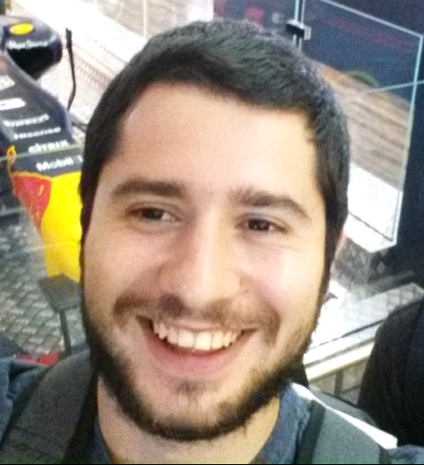
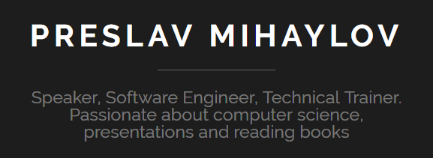
Video Lessons: Preslav Mihaylov
Preslav Mihaylov – https://pmihaylov.com
Experienced software engineer, trainer, blockchain developer and conference speaker
Head of Blockchain Training @ SoftUni
Experienced in embedded software, robotics, Internet of Things (IoT)
Passionate about computer science, presentations and reading books

Slide 6

Trainers and Contributors
Let’s Start!

