Slide 1
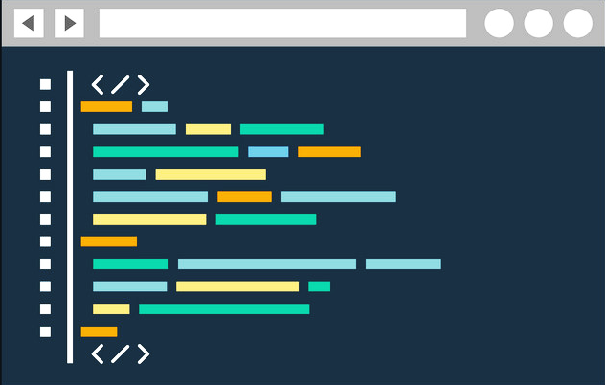

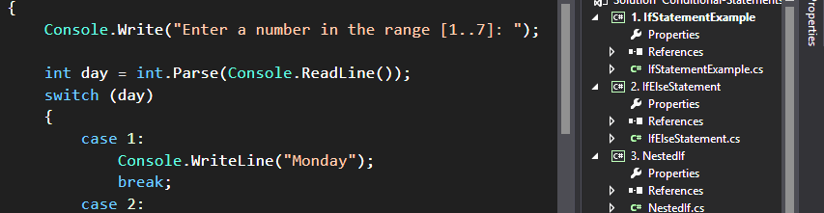
First Steps in Programming
Writing Our First Program in C# and Visual Studio
Programming Basics
Dr. Svetlin Nakov
Co-Founder, Chief Training, Innovation and Inspiration
Software University / SoftUni
https://softuni.org

Slide 2

Table of Contents
What Does It Mean "To Program"?
Writing Commands and Programs
Programming Languages and Runtimes
Computer Programs – Examples
Creating Our First Console Application
Creating a C# Program in Visual Studio
Starting & Testing the Program
Typical Mistakes in a C# Program

Slide 3

First Steps in Programming
Let’s Begin!

