Slide 1


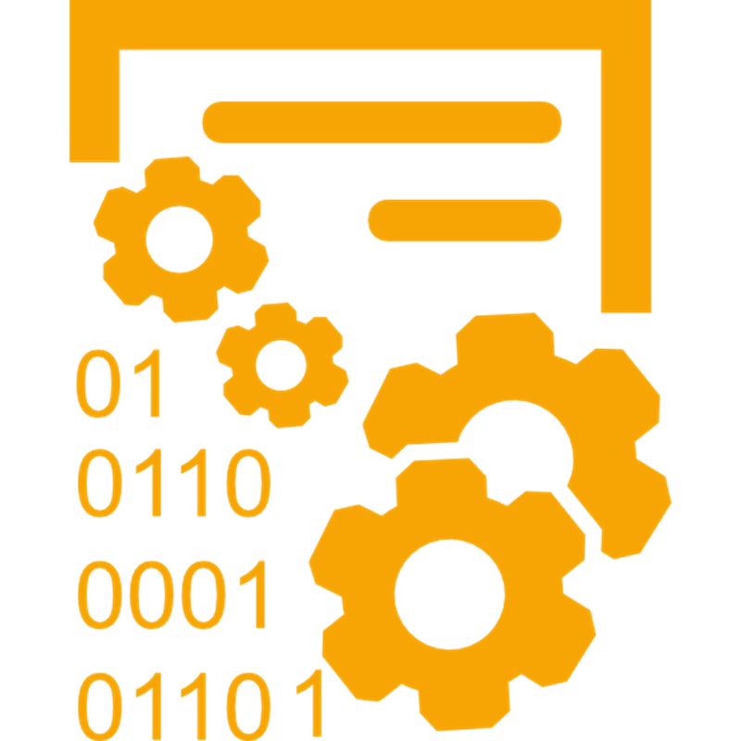
Programming Languages: High Level and Low Level

Slide 2
Runtime Environments
Computer programs are typically executed by a runtime environment (a system for executing programs)
C# is executed by the .NET Core runtime environment
Java is executed by Java JRE runtime environment
Python is executed by the Python interpreter environment
JavaScript is executed by the Node.js runtime environment (at the back-end) or by the Web browser (at the front-end)

Slide 3
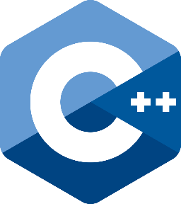

Low-level and High-level Languages
Low-level programming languages are closer to the device hardware
Harder to write in them – a lot of code for simple results
Easier hardware access and control
Examples: Assembler, C, C++
High-level languages provide a higher level of abstraction
More comfort and easier to write code and build software
Less control over the hardware
Examples: C#, Python, JavaScript

Slide 4
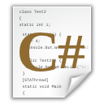

The C# Programming Language and .NET
C# is a high-level language, which is compiled
A program in C# is written in text format (source code)
The result of execution is called an executable file (prog.exe)
C# uses a handful of tools, given by the .NET Core
Virtual Machine, Compilers, Runtime Environment (CLR)
compiler
execution
source code
compiled code
execution engine (.NET CLR)

Slide 5

Programming Languages
Go Ahead!

