Slide 1
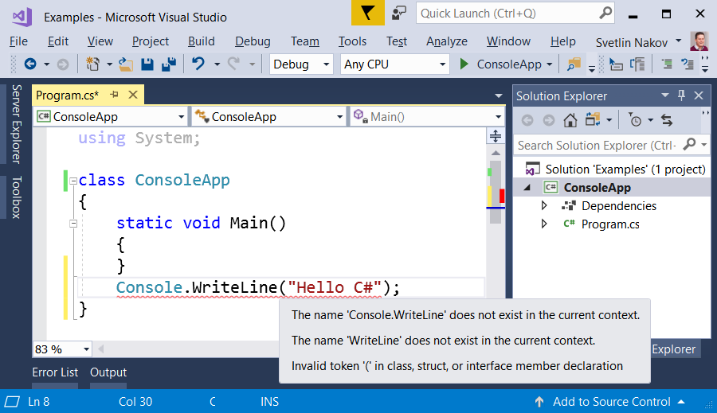
Typical Mistakes in a C# Program

Slide 2






Typical Mistakes in a C# Program
Writing outside the Main() method:
Wrong capital/lower casing:
Missing ; at the end of every command
Missing quote " or bracket ( or )

Slide 3

Typical Mistakes in a C# Program
Try It Yourself!

