Slide 1
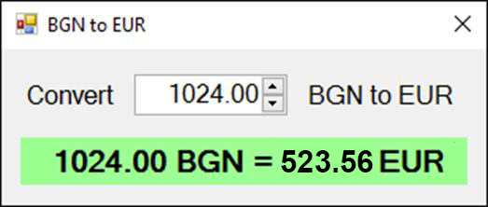
BGN to EUR converter graphical application

Slide 2
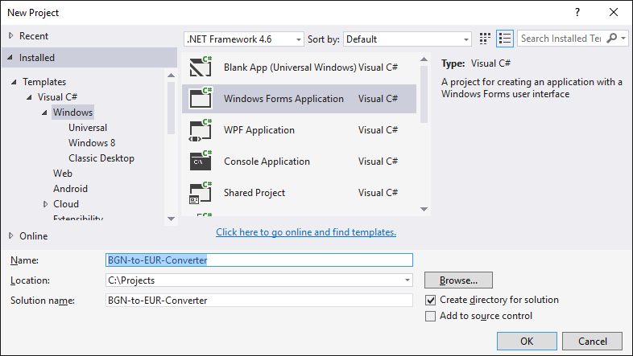
Currency Converter
Create a new Windows Forms Application

Slide 3
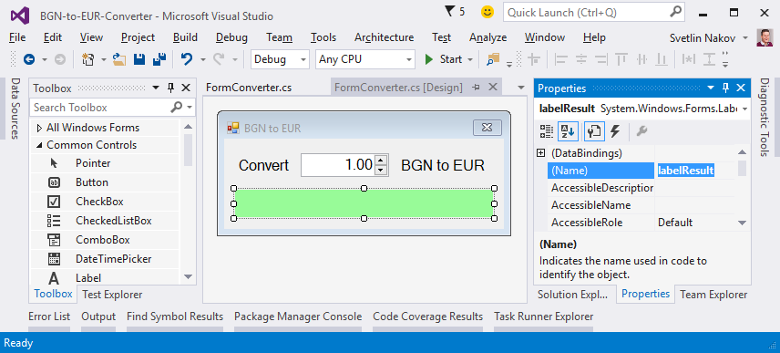
Configure the controls of the form

Slide 4
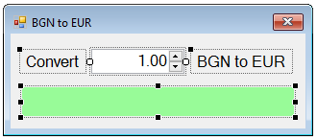
Settings of the form controls
numericUpDownAmount
Value = 1
Minimum = 0
Maximum = 10000000
TextAlign = Right
DecimalPlaces = 2
FormConverter
Text = "BGN to EUR"
Font.Size = 12
MaximizeBox = False
MinimizeBox = False
FormBorderStyle = FixedSingle
labelResult
AutoSize = False
BackColor = PaleGreen
TextAlign = MiddleCenter
Font.Size = 14
Font.Bold = True

Slide 5
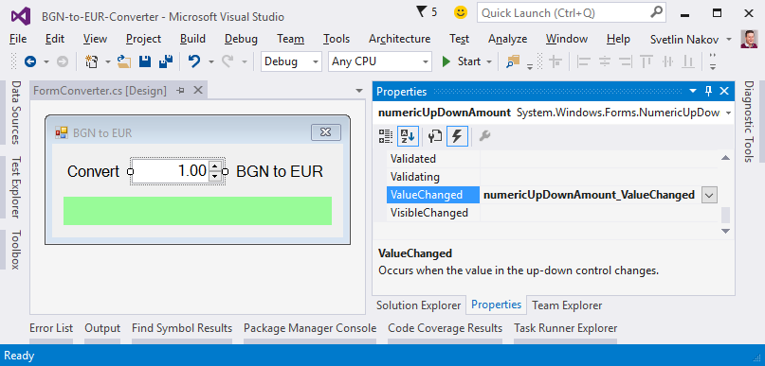
Handling events

Slide 6
Events of the controls
private void FormConverter_Load(
object sender, EventArgs e)
{ ConvertCurrency(); }
private void numericUpDownAmount_ValueChanged(
object sender, EventArgs e)
{ ConvertCurrency(); }
private void numericUpDownAmount_KeyUp(
object sender, KeyEventArgs e)
{ ConvertCurrency(); }

Slide 7
Converting from BGN to EUR – logic
private void ConvertCurrency()
{
var amountBGN = this.numericUpDownAmount.Value;
var amountEUR = amountBGN * 1.95583m;
this.labelResult.Text =
amountBGN + " BGN = " +
Math.Round(amountEUR, 2) + " EUR";
}

Slide 8

BGN to EUR graphical application
Try it yourself!

