Slide 1
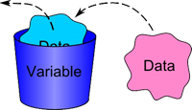
Variable Scope
The lifecycle of a variable

Slide 2
Variable Scope
The scope in which a variable can be used
var myBankAccount = Bank.GetMyBankAccount();
if (DateTime.Now().Day >= PayDay)
{
var salary = Job.GetMyMonthlySalary();
myBankAccount = myBankAccount + salary;
}
Console.WriteLine(myBankAccount);
// Console.WriteLine(salary) Error!

Slide 3

Variable Scope
Try it yourself!

