Slide 1

Debugging
Simple operations with a debugger

Slide 2
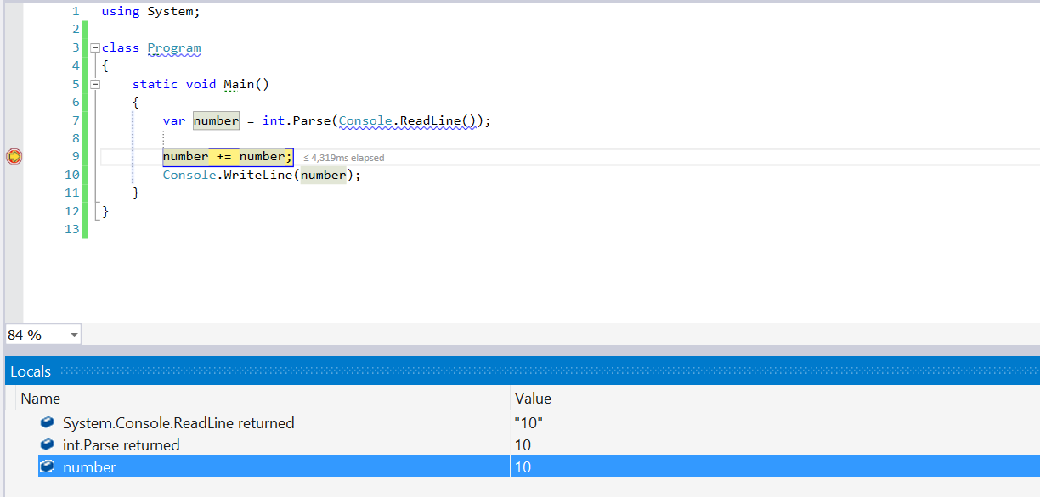
Debugging
The process of „attaching“ to the program execution, which allows us to track the program execution
This enables us to find bugs

Slide 3
Debugging in Visual Studio
Pressing [F10] will start the program in debug state.
We can continue to the next step again [F10]
We can add breakpoints [F9]
We can reach them directly using [F5]

Slide 4

Debugging
Try it yourself!

