Slide 1
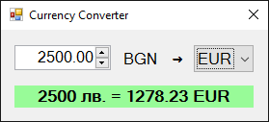
Graphical Application: Currency Converter

Slide 2
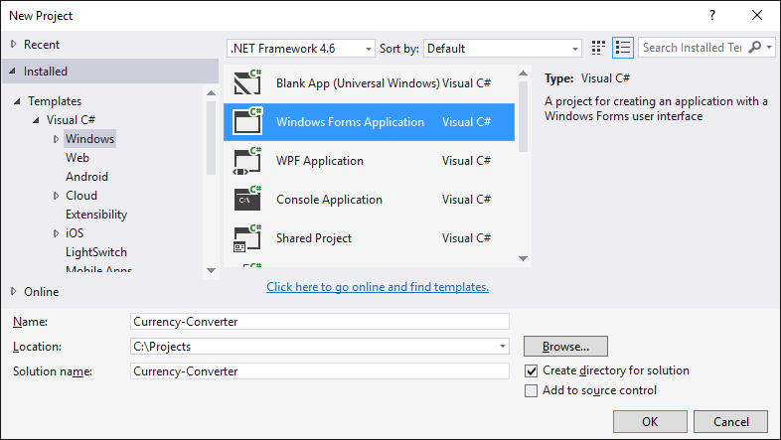
Currency Converter
Creating a new Windows Forms Application

Slide 3
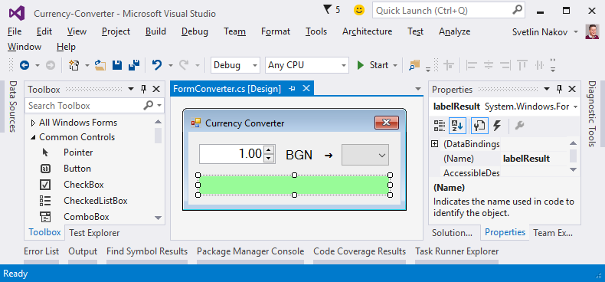
Ordering the controls in the editor

Slide 4
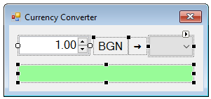
Configuring the controls
FormConverter
Text = "Currency Converter"
Font.Size = 12
MaximizeBox = False
MinimizeBox = False
FormBorderStyle = FixedSingle
numericUpDownAmount
Value = 1
Minimum = 0
Maximum = 1000000
TextAlign = Right
DecimalPlaces = 2

Slide 5
Configuring the controls (2)
comboBoxCurrency
DropDownStyle = DropDownList
Items =
EUR
USD
GBP
labelResult
AutoSize = False
BackColor = PaleGreen
TextAlign = MiddleCenter
Font.Size = 14
Font.Bold = True

Slide 6
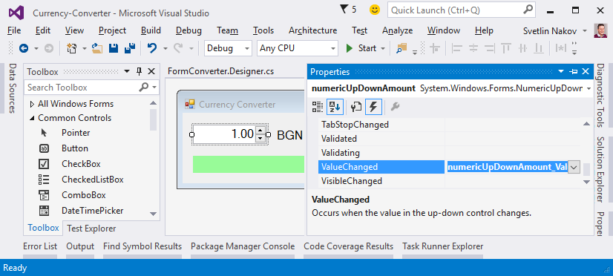
Event handling

Slide 7
Events in controls
private void FormConverter_Load(object sender, EventArgs e)
{ this.comboBoxCurrency.SelectedItem = "EUR"; }
private void numericUpDownAmount_ValueChanged(
object sender, EventArgs e)
{ ConvertCurrency(); }
private void comboBoxCurrency_SelectedIndexChanged(
object sender, EventArgs e)
{ ConvertCurrency(); }

Slide 8
Converting currencies
private void ConvertCurrency()
{
var originalAmount = this.numericUpDownAmount.Value;
var convertedAmount = originalAmount;
if (this.comboBoxCurrency.SelectedItem.ToString() == "EUR")
convertedAmount = originalAmount / 1.95583m;
else if (this.comboBoxCurrency.SelectedItem.ToString() == "USD")
convertedAmount = originalAmount / 1.80810m;
else if (this.comboBoxCurrency.SelectedItem.ToString() == "GBP")
convertedAmount = originalAmount / 2.54990m;
this.labelResult.Text = originalAmount + " лв. = " +
Math.Round(convertedAmount, 2) + " " +
this.comboBoxCurrency.SelectedItem;
}

Slide 9

Graphical Application: Currency Converter
Try it yourself!

