Slide 1
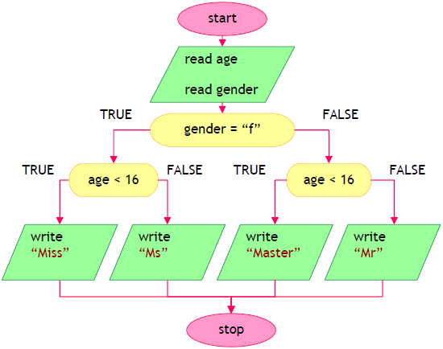
Problem - Address person

Slide 2
Address person
Given age and gender (m / f) print a correct addressing:
“Mr.” – man (gender “m”) aged 16 or more
“Master” – boy (gender “m”) under 16 years
“Ms.” – woman (gender “f”) aged 16 or more
“Miss” – girl (gender “f”) under 16 years
12
f
Miss
16
m
Mr.

Slide 3
Solution: Address person
var age = double.Parse(Console.ReadLine());
var gender = Console.ReadLine();
if (age < 16)
{
if (gender == "m") Console.WriteLine("Master");
else if (gender == "f") Console.WriteLine("Miss");
}
else
{
if (gender == "m") Console.WriteLine("Mr.");
else if (gender == "f") Console.WriteLine("Ms.");
}
Testing the solution: https://judge.softuni.bg/Contests/Practice/Index/153#0

Slide 4

Address person
Try it yourself

