Slide 1
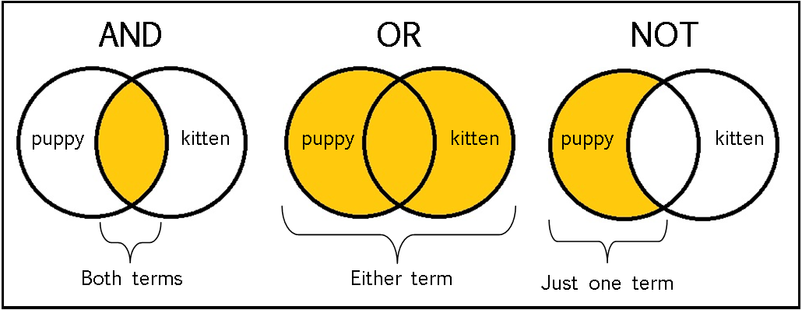

Complex conditions
Logical "and", logical "or", logical negation and brackets

Slide 2
Logical "AND"

Slide 3
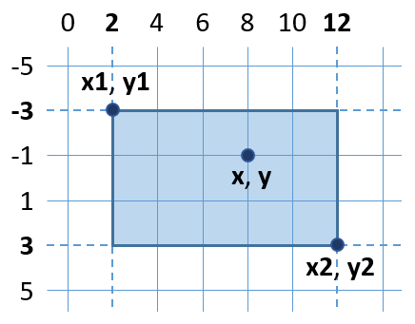
Logical "AND"
Logical "AND" (operator &&) means to check if several conditions are met simultaneously
Example: check if a given point {x, y} is inside a rectangle {x1, y1} – {x2, y2}
The point {x, y} should be:
Right of x1 and left of x2 and below y1 and above y2
if (x >= x1 && x <= x2 && y >= y1 && y <= y2) …

Slide 4
Example: Point in rectangle
A point is inside a rectangle if it is:
Right of its left side, left of its right side, below its upper part and above its lower part
var x = 8, y = -1;
var x1 = 2, y1 = -3;
var x2 = 12, y2 = 3;
if (x >= x1 && x <= x2 && y >= y1 && y <= y2)
Console.WriteLine("Inside");
else
Console.WriteLine("Outside");
Testing the solution: https://judge.softuni.bg/Contests/Practice/Index/153#2

Slide 5

Logical "AND"
Try it yourself

