Slide 1

Logical Negation

Slide 2
Logical negation
Logical negation (operator !) means that a given condition is not met
Example:
A given number is valid, if it is in the [100…200] range or it is 0
Check if the number is invalid
var inRange = (num >= 100 && num <= 200) || num == 0;
if (!inRange)
Console.WriteLine("invalid");
Testing the solution: https://judge.softuni.bg/Contests/Practice/Index/153#4

Slide 3
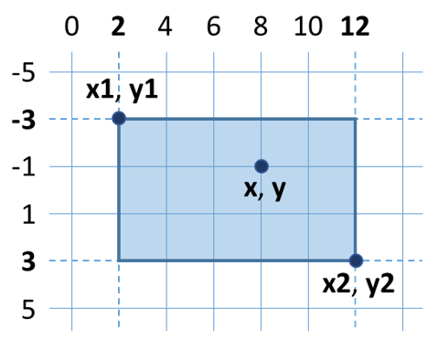
Example: Point on a rectangle border
Write a program, which reads 6 whole numbers x1, y1, x2, y2, x и y
Prints whether the point is on the rectangle border or not
Constraints: x1 < x2 and y1 < y2
2
-3
12
3
8
-1
Inside / Outside
2
-3
12
3
12
-1
Border

Slide 4

Logical Negation
Try it yourself

