Slide 1
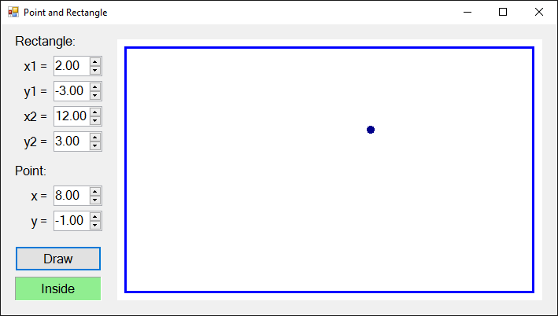
Point in rectangle
Graphical (GUI) application

Slide 2
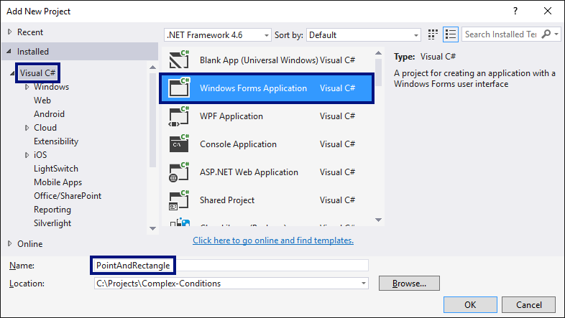
New Windows Forms project

Slide 3
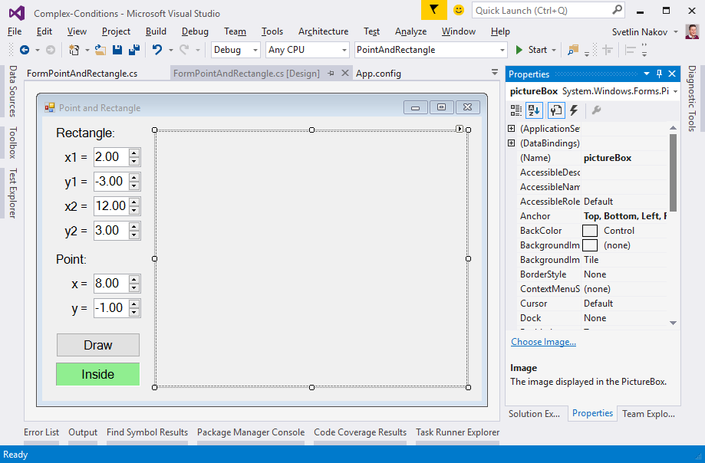
Order the controls in the form

Slide 4
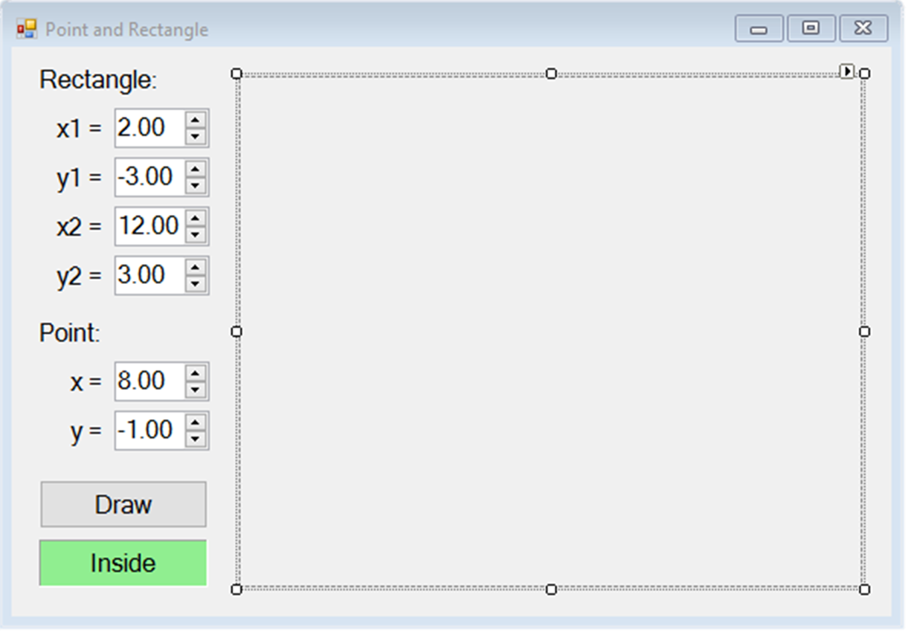
Properties of controls
FormPointAndRectangle
Text = "Point and Rectangle"
Font.Size = 12
Size = 700, 410
MinimumSize = 500, 400
FormBorderStyle = FixedSingle
numericUpDownX1,X2,Y1,Y2,X,Y
Values = 2; -3; 12; 3; 8; -1
Minimum = -100000
Maximum = 100000
DecimalPlaces = 2

Slide 5
Properties of controls (2)
pictureBox
Anchor = Top, Bottom, Left, Right
buttonDraw
Text = "Draw"
labelLocation
AutoSize = False
BackColor = PaleGreen
TextAlign = MiddleCenter

Slide 6
Handling events in the controller
All the events invoke Draw():
Handle the following events:
buttonDraw.Click
numericUpDownX1.ValueChanged, numericUpDownY1.ValueChanged, numericUpDownX2.ValueChanged, numericUpDownY2.ValueChanged, numericUpDownX.ValueChanged и numericUpDownY.ValueChanged
FormPointAndRectangle.Load и FormPointAndRectangle.Resize
private void buttonDraw_Click(
object sender,
EventArgs e)
{
Draw();
}

Slide 7
Writing the visualization code
private void Draw()
{
// Get the rectangle and point coordinates from the form
var x1 = this.numericUpDownX1.Value;
var y1 = this.numericUpDownY1.Value;
var x2 = this.numericUpDownX2.Value;
var y2 = this.numericUpDownY2.Value;
var x = this.numericUpDownX.Value;
var y = this.numericUpDownY.Value;
// Display the point location: Inside / Border / Outside
DisplayPointLocation(x1, y1, x2, y2, x, y);
// TODO: finish this …
}
There is a lot of code to write. Check the exercises

Slide 8

Point in rectangle
Try it yourself

