Slide 1
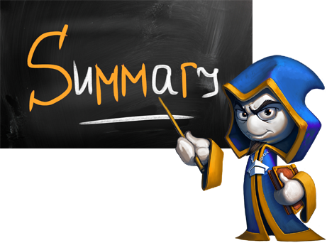
What did we learn today?

Slide 2
What did we learn today?
Nested checks:
More complex conditions with &&, ||, ! and ()
if (condition1)
{
if (condition2) …
else …
}
if ((x == left || x == right) && y >= top && y <= bottom)
Console.WriteLine("Point on the left or right side.");

Slide 3

What did we learn today?
Do the exercises!

