Slide 1

Repetitions (Loops)
Simple repetitions with for-loop
Programming Basics
Preslav Mihaylov
Head of Training & Software Engineer
Software University / SoftUni
https://softuni.org

Slide 2

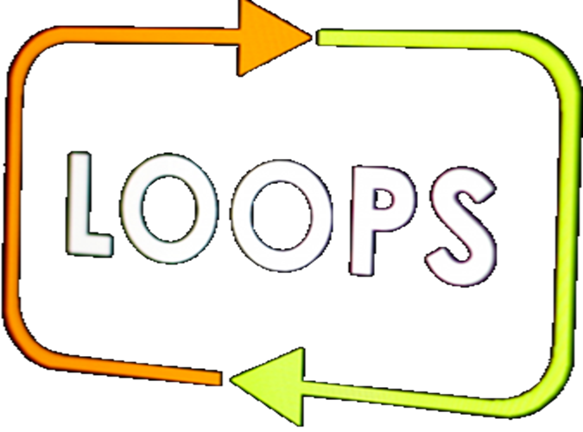
Table of Contents
Repetitions (loops)
for-loop in his simplest form
Solving problems with for-loops
Sum of n numbers, greatest and smallest number
Sum of vowels
Drawing figures with Turtle Graphics – GUI Application for Windows

Slide 3

Complex Conditions
Let’s Begin!

