Slide 1
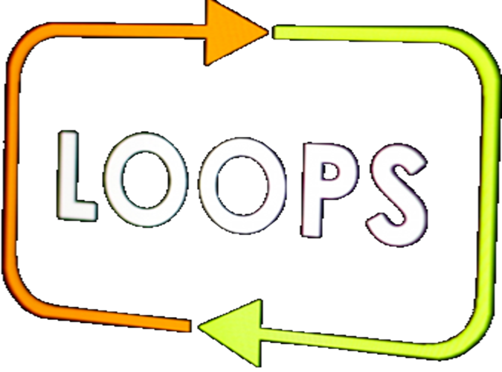
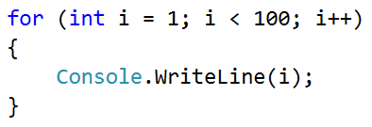
Repetitions of blocks of code
For-loop statement

Slide 2
Repetitions (loops)
In programming, we often have to execute a block of code several times
For that purpose, we use for-loop
for–loop statement
Initial value
Final value
Loop body: block of commands
for (var i = 1; i <= 10; i++)
{
Console.WriteLine("i = " + i);
}

Slide 3

Repetitions (loops)
Try it yourself

