Slide 1

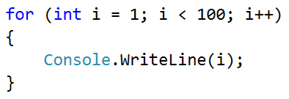
Example: Numbers from 1 to 100

Slide 2

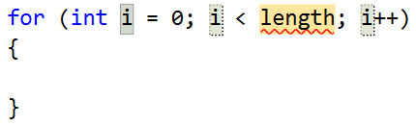
Example: numbers from 1 to 100
Write a program, which prints the numbers from 1 to 100:
You can use "for-loop" code snippet in Visual Studio
for (var i = 1; i <= 100; i++)
{
Console.WriteLine(i);
}
Press [TAB] two times
Testing the solution: https://judge.softuni.bg/Contests/Practice/Index/154#0

Slide 3

Example: numbers from 1 to 100
Try it yourself

