Slide 1

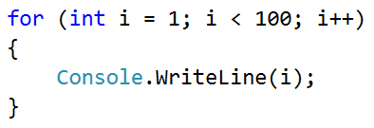
Numbers until 1000, ending in 7

Slide 2
Numbers until 1000, ending in 7
Write a program, which finds all numbers from [1…1000], which end in 7:
for (var i = 0; i <= 1000; i++)
{
if (i % 10 == 7)
{
Console.WriteLine(i);
}
}
Testing the solution: https://judge.softuni.bg/Contests/Practice/Index/154#1

Slide 3

Numbers until 1000, ending in 7
Try it yourself

