Slide 1
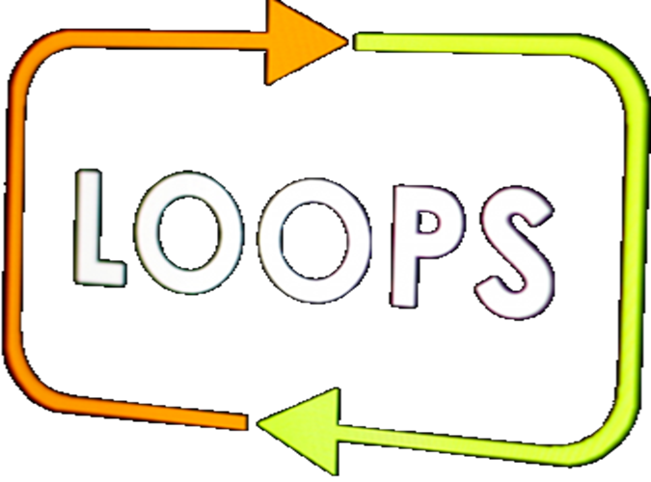
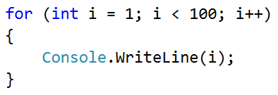
All Latin Letters

Slide 2
All Latin Letters
Write a program, which prints the letters from the Latin alphabet: a … z
For-loops work not only with numbers, but with letters as well:
Console.Write("Latin alphabet:");
for (var letter = 'a'; letter <= 'z'; letter++)
{
Console.Write(" " + letter);
}
Console.WriteLine();
Testing the solution: https://judge.softuni.bg/Contests/Practice/Index/154#2

Slide 3

All Latin Letters
Try it yourself

