Slide 1

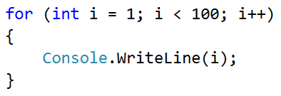
Sum of Numbers

Slide 2
Sum of numbers
Write a program, which inputs n numbers and finds their sum
The first number n determines how many numbers are input
On the next n lines, a number is input
The numbers are summed and the result is printed
Examples:
2
10
20
30
3
-10
-20
-30
-60
4
45
-20
7
11
43

Slide 3
Solution: Sum of numbers
Console.Write("n = ");
var n = int.Parse(Console.ReadLine());
Console.WriteLine("Enter the numbers:");
var sum = 0;
for (var i = 0; i < n; i++)
{
var num = int.Parse(Console.ReadLine());
sum = sum + num;
}
Console.WriteLine("sum = " + sum);
Testing the solution: https://judge.softuni.bg/Contests/Practice/Index/154#3

Slide 4

Sum of Numbers
Try it yourself

