Slide 1

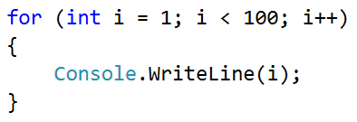
Largest Number

Slide 2
Largest Number
Write a program, which takes n numbers as input and finds the largest amongst them
The first line of input represents the number n
On the next lines we have n numbers
Examples:
2
100
99
100
3
-10
20
-30
20
4
45
-20
7
99
99

Slide 3
Solution: Largest Number
Console.Write("n = ");
var n = int.Parse(Console.ReadLine());
var max = -10000000000000;
for (var i = 1; i <= n; i++)
{
var num = int.Parse(Console.ReadLine());
if (num > max)
max = num;
}
Console.WriteLine("max = " + max);
Testing the solution: https://judge.softuni.bg/Contests/Practice/Index/154#4

Slide 4

Largest Number
Try it yourself

