Slide 1

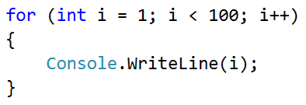
Smallest Number

Slide 2
Smallest Number
Write a program, which takes n numbers as input and finds the smallest amongst them
The first line of input represents the number n
On the next lines we have n numbers
2
99
100
99
3
-10
20
-30
-30
4
45
-20
7
99
-20
Testing the solution: https://judge.softuni.bg/Contests/Practice/Index/154#5

Slide 3

Smallest Number
Try it yourself

