Slide 1
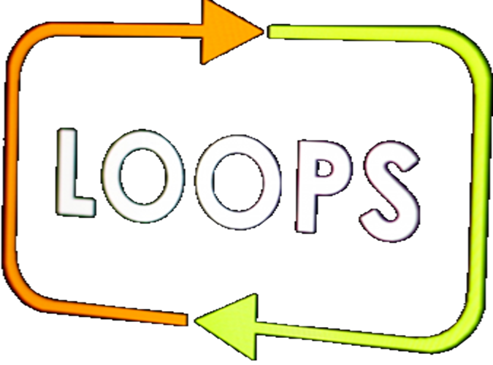
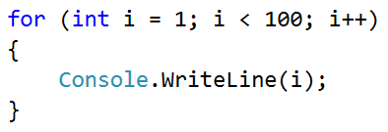
Left and Right Sum

Slide 2
Left and Right Sum
Write a program, which takes 2*n numbers as input
Checks if the sum of the left n and right n numbers are equal
If they are, print "Yes" + the sum; Otherwise, print "No" + the difference
Examples:
2
10
90
60
40
Yes, sum = 100
2
90
9
50
50
No, diff = 1

Slide 3
Solution - Left and Right Sum
var n = int.Parse(Console.ReadLine());
var leftSum = 0;
for (var i = 0; i < n; i++)
leftSum = leftSum + int.Parse(Console.ReadLine());
// TODO: read and calculate the rightSum
if (leftSum == rightSum)
Console.WriteLine("Yes, sum = " + leftSum);
else
Console.WriteLine("No, diff = " +
Math.Abs(rightSum - leftSum));
Testing the solution: https://judge.softuni.bg/Contests/Practice/Index/154#6

Slide 4

Left and Right Sum
Try it yourself

