Slide 1
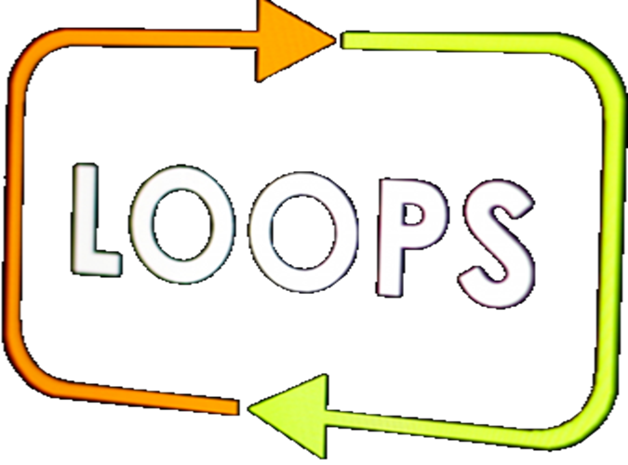
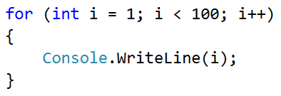
Even / Odd Sum

Slide 2
Even / Odd Sum
Write a program, which inputs n numbers
Checks if the sum of the numbers in even positions is equal to the sum of the numbers in uneven positions
If they are equal, print "Yes" + the sum; otherwise, print "No" + the difference. Examples:
4
10
50
60
20
Yes
Sum = 70
4
3
5
1
-2
No
Diff = 1
3
5
8
1
No
Diff = 2

Slide 3
Solution – Even / Odd Sum
var n = int.Parse(Console.ReadLine());
var oddSum = 0;
var evenSum = 0;
for (var i = 0; i < n; i++)
{
var element = int.Parse(Console.ReadLine());
if (i % 2 == 0) oddSum += element;
else evenSum += element;
}
// TODO: print the sum / difference
Testing the solution: https://judge.softuni.bg/Contests/Practice/Index/154#7

Slide 4

Even / Odd Sum
Try it yourself

