Slide 1

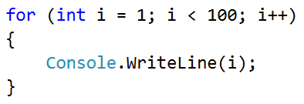
Sum of Vowels

Slide 2
Sum of Vowels
Write a program, which reads input text (string)
Prints the sum of vowels according to the table below:
Examples:
a | e | i | o | u
1 | 2 | 3 | 4 | 5
hello
6
(e+o = 2+4 = 6)
hi
3
(i = 3)
bamboo
9
(a+o+o = 1+4+4 = 9)
beer
4
(e+e = 2+2 = 4)

Slide 3
Solution - Sum of Vowels
var s = Console.ReadLine();
var sum = 0;
for (int i = 0; i < s.Length; i++)
if (s[i] == 'a') sum += 1;
else if (s[i] == 'e') sum += 2;
else if (s[i] == 'i') sum += 3;
else if (s[i] == 'o') sum += 4;
else if (s[i] == 'u') sum += 5;
Console.WriteLine("Vowels sum = " + sum);
Testing the solution: https://judge.softuni.bg/Contests/Practice/Index/154#8

Slide 4

Sum of Vowels
Try it yourself

