Slide 1
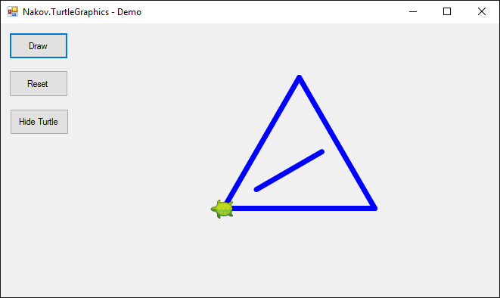


Drawing Figures with Turtle Graphics
Graphical (GUI) application

Slide 2
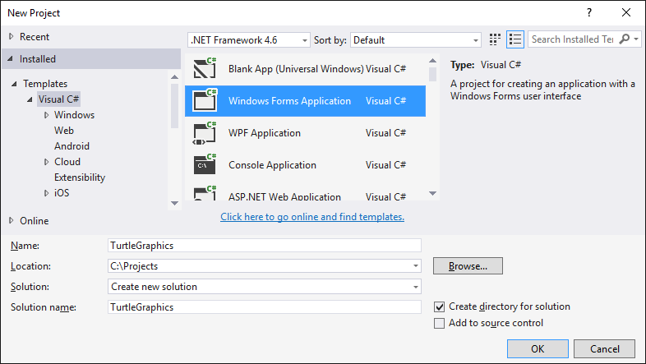
New Windows Forms Project

Slide 3
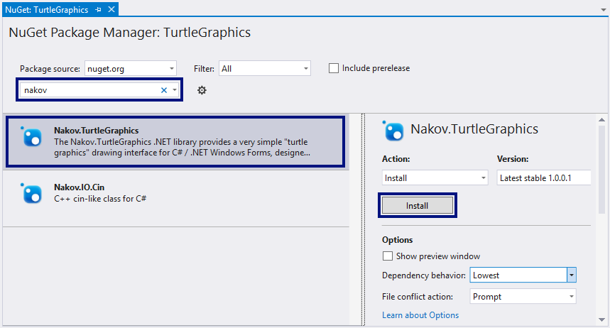
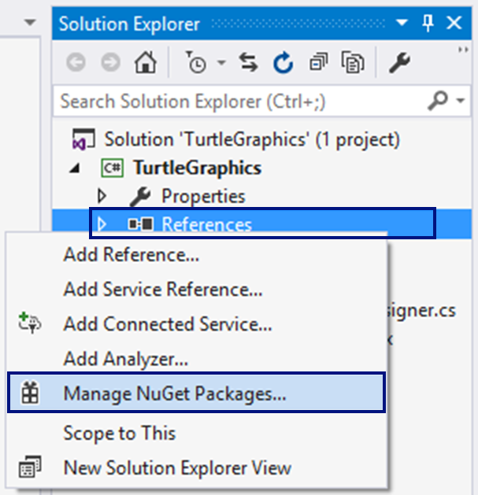
Install NuGet package "Nakov.TurtleGraphics"

Slide 4
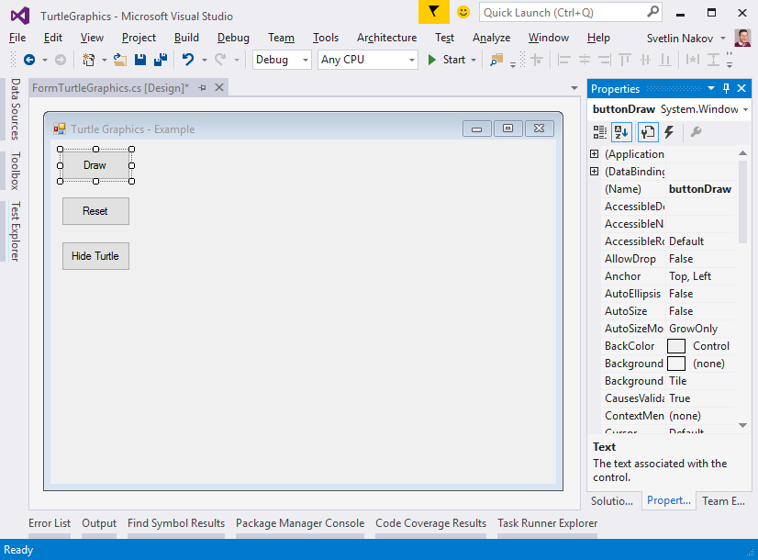
Design the Main Form
private void buttonDraw_Click(
object sender,
EventArgs e)
{
Turtle.Rotate(30);
Turtle.Forward(200);
Turtle.Rotate(120);
Turtle.Forward(200);
Turtle.Rotate(120);
Turtle.Forward(200);
…
}
FormTurtleGraphics
Text = "Turtle Graphics - Example"
buttonDraw
Text = "Draw"
buttonReset
Text = "Reset"
buttonShowHideTurtle
Text = "Hide Turtle"

Slide 5
The Application in Action

Slide 6

Drawing Figures with Turtle Graphics
Try it yourself

