Slide 1
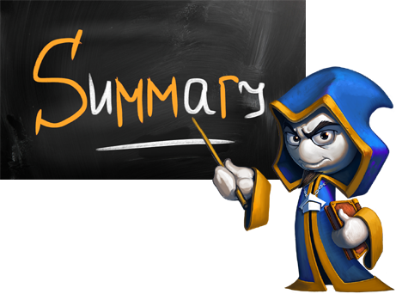
What did we learn today?

Slide 2
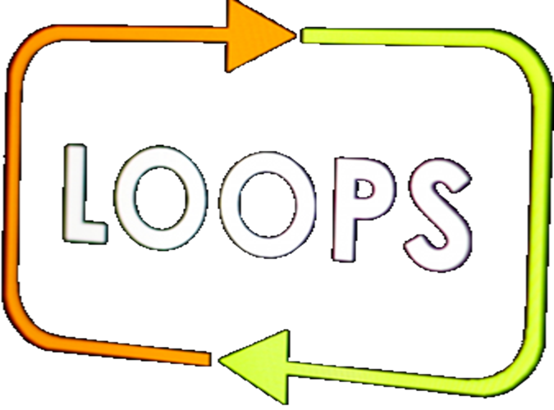
What did we learn today?
We can repeat a block of code with a for-loop:
We can read a sequence of n numbers from the terminal:
for (var i = 1; i <= 10; i++)
{
Console.WriteLine("i = " + i);
}
var n = int.Parse(Console.ReadLine());
for (var i = 0; i < n; i++)
{ var num = int.Parse(Console.ReadLine()); … }

Slide 3

What did we learn today?
Do the exercises!

