Slide 1


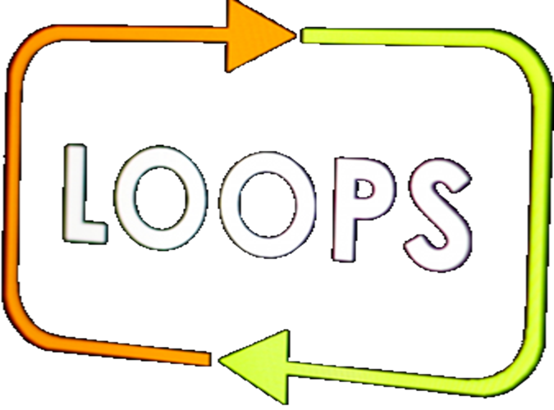

Repetitions (Loops)
Simple repetitions with for-loop
loops
СофтУни
трейнърски екип
Софтуерен университет
http://softuni.bg

Slide 2

Table of Contents
Repetitions (loops)
for-loop in his simplest form
Solving problems with for-loops
Sum of n numbers, greatest and smallest number
Sum of vowels
Drawing figures with Turtle Graphics – GUI Application for Windows

Slide 3
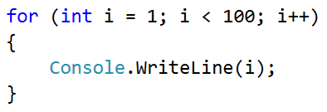
Repetitions of blocks of code
For-loop statement

Slide 4
Repetitions (loops)
In programming, we often have to execute a block of code several times
For that purpose, we use for-loop
for–loop statement
Initial value
Final value
Loop body: block of commands
for (var i = 1; i <= 10; i++)
{
Console.WriteLine("i = " + i);
}

Slide 5

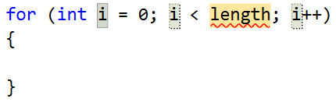
Example: numbers from 1 to 100
Write a program, which prints the numbers from 1 to 100:
You can use "for-loop" code snippet in Visual Studio
for (var i = 1; i <= 100; i++)
{
Console.WriteLine(i);
}
Press [TAB] two times
Testing the solution: https://judge.softuni.bg/Contests/Practice/Index/154#0

Slide 6
Example: numbers until 1000, ending in 7
Write a program, which finds all numbers from [1…1000], which end in 7:
for (var i = 0; i <= 1000; i++)
{
if (i % 10 == 7)
{
Console.WriteLine(i);
}
}
Testing the solution: https://judge.softuni.bg/Contests/Practice/Index/154#1

Slide 7
Example: All latin letters
Write a program, which prints the letters from the Latin alphabet: a … z
For-loops work not only with numbers, but with letters as well:
Console.Write("Latin alphabet:");
for (var letter = 'a'; letter <= 'z'; letter++)
{
Console.Write(" " + letter);
}
Console.WriteLine();
Testing the solution: https://judge.softuni.bg/Contests/Practice/Index/154#2

Slide 8
Example: Sum of numbers
Write a program, which inputs n numbers and finds their sum
The first number n determines how many numbers are input
On the next n lines, a number is input
The numbers are summed and the result is printed
Examples:
2
10
20
30
3
-10
-20
-30
-60
4
45
-20
7
11
43

Slide 9
Solution: Sum of numbers
Console.Write("n = ");
var n = int.Parse(Console.ReadLine());
Console.WriteLine("Enter the numbers:");
var sum = 0;
for (var i = 0; i < n; i++)
{
var num = int.Parse(Console.ReadLine());
sum = sum + num;
}
Console.WriteLine("sum = " + sum);
Testing the solution: https://judge.softuni.bg/Contests/Practice/Index/154#3

Slide 10
Example: Largest Number
Write a program, which takes n numbers as input and finds the largest amongst them
The first line of input represents the number n
On the next lines we have n numbers
Examples:
2
100
99
100
3
-10
20
-30
20
4
45
-20
7
99
99

Slide 11
Solution: Largest Number
Console.Write("n = ");
var n = int.Parse(Console.ReadLine());
var max = -10000000000000;
for (var i = 1; i <= n; i++)
{
var num = int.Parse(Console.ReadLine());
if (num > max)
max = num;
}
Console.WriteLine("max = " + max);
Testing the solution: https://judge.softuni.bg/Contests/Practice/Index/154#4

Slide 12
Example: Smallest Number
Write a program, which takes n numbers as input and finds the smallest amongst them
The first line of input represents the number n
On the next lines we have n numbers
2
99
100
99
3
-10
20
-30
-30
4
45
-20
7
99
-20
Testing the solution: https://judge.softuni.bg/Contests/Practice/Index/154#5

Slide 13



Problems with for-loops
for-loops
Techniques for using for-loops

Slide 14
Problem: left and right sum
Write a program, which takes 2*n numbers as input
Checks if the sum of the left n and right n numbers are equal
If they are, print "Yes" + the sum; Otherwise, print "No" + the difference
Examples:
2
10
90
60
40
Yes, sum = 100
2
90
9
50
50
No, diff = 1

Slide 15
Solution: left and right sum
var n = int.Parse(Console.ReadLine());
var leftSum = 0;
for (var i = 0; i < n; i++)
leftSum = leftSum + int.Parse(Console.ReadLine());
// TODO: read and calculate the rightSum
if (leftSum == rightSum)
Console.WriteLine("Yes, sum = " + leftSum);
else
Console.WriteLine("No, diff = " +
Math.Abs(rightSum - leftSum));
Testing the solution: https://judge.softuni.bg/Contests/Practice/Index/154#6

Slide 16
Problem: even / uneven sum
Write a program, which inputs n numbers
Checks if the sum of the numbers in even positions is equal to the sum of the numbers in uneven positions
If they are equal, print "Yes" + the sum; otherwise, print "No" + the difference. Examples:
4
10
50
60
20
Yes
Sum = 70
4
3
5
1
-2
No
Diff = 1
3
5
8
1
No
Diff = 2

Slide 17
Solution: even / uneven sum
var n = int.Parse(Console.ReadLine());
var oddSum = 0;
var evenSum = 0;
for (var i = 0; i < n; i++)
{
var element = int.Parse(Console.ReadLine());
if (i % 2 == 0) oddSum += element;
else evenSum += element;
}
// TODO: print the sum / difference
Testing the solution: https://judge.softuni.bg/Contests/Practice/Index/154#7

Slide 18
Problem: Sum of Vowels
Write a program, which reads input text (string)
Prints the sum of vowels according to the table below:
Examples:
a | e | i | o | u
1 | 2 | 3 | 4 | 5
hello
6
(e+o = 2+4 = 6)
hi
3
(i = 3)
bamboo
9
(a+o+o = 1+4+4 = 9)
beer
4
(e+e = 2+2 = 4)

Slide 19
Solution: Sum of Vowels
var s = Console.ReadLine();
var sum = 0;
for (int i = 0; i < s.Length; i++)
if (s[i] == 'a') sum += 1;
else if (s[i] == 'e') sum += 2;
else if (s[i] == 'i') sum += 3;
else if (s[i] == 'o') sum += 4;
else if (s[i] == 'u') sum += 5;
Console.WriteLine("Vowels sum = " + sum);
Testing the solution: https://judge.softuni.bg/Contests/Practice/Index/154#8

Slide 20
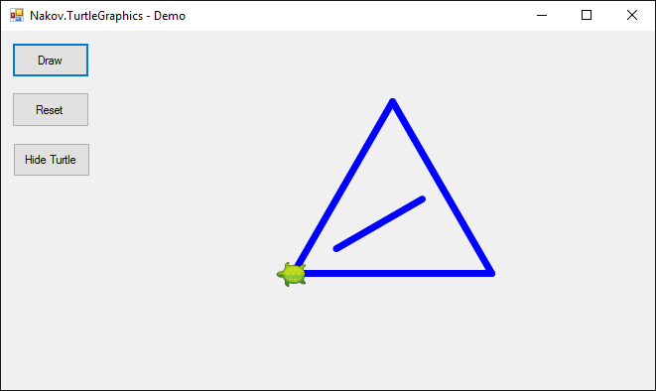


Drawing figures with Turtle Graphics
Graphical (GUI) application

Slide 21
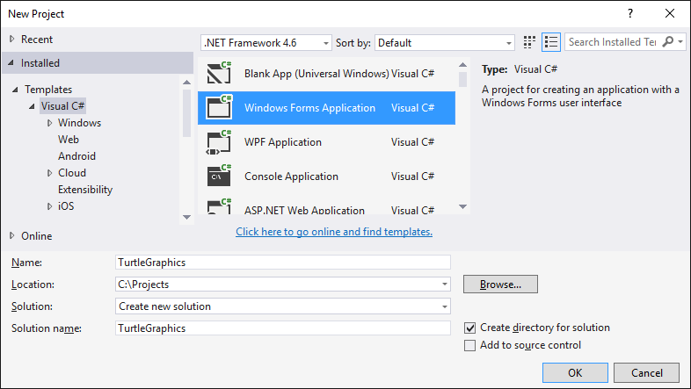
New Windows Forms Project

Slide 22
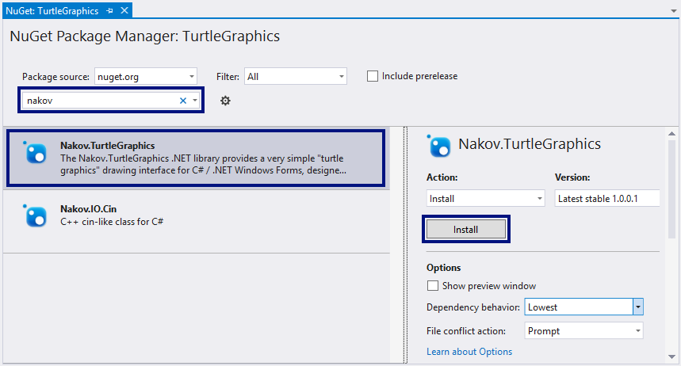
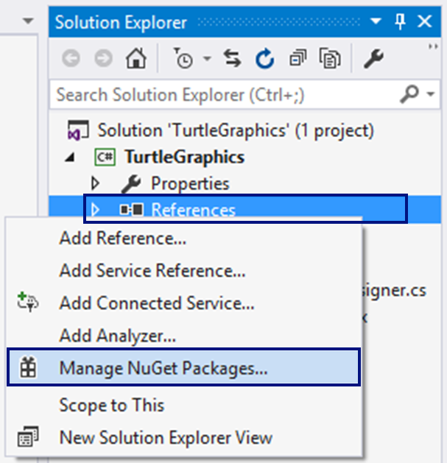
Install NuGet package "Nakov.TurtleGraphics"

Slide 23
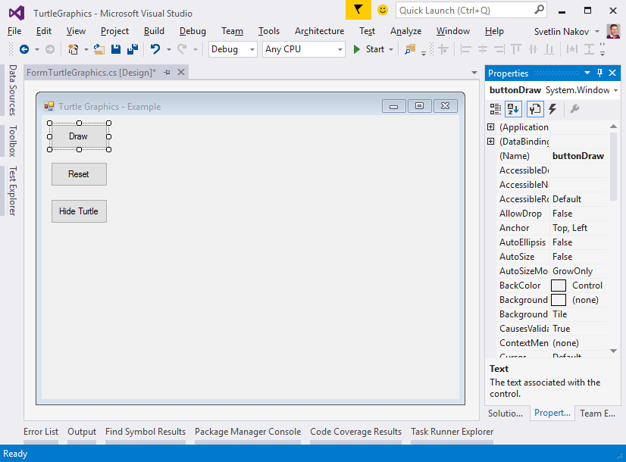
Design the Main Form
private void buttonDraw_Click(
object sender,
EventArgs e)
{
Turtle.Rotate(30);
Turtle.Forward(200);
Turtle.Rotate(120);
Turtle.Forward(200);
Turtle.Rotate(120);
Turtle.Forward(200);
…
}
FormTurtleGraphics
Text = "Turtle Graphics - Example"
buttonDraw
Text = "Draw"
buttonReset
Text = "Reset"
buttonShowHideTurtle
Text = "Hide Turtle"

Slide 24
The Application in Action

Slide 25
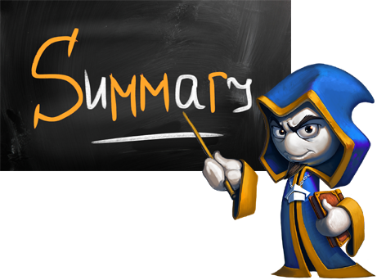
What did we learn today?
We can repeat a block of code with a for-loop:
We can read a sequence of n numbers from the terminal:
for (var i = 1; i <= 10; i++)
{
Console.WriteLine("i = " + i);
}
var n = int.Parse(Console.ReadLine());
for (var i = 0; i < n; i++)
{ var num = int.Parse(Console.ReadLine()); … }

