Slide 1
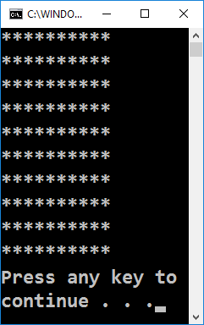
Rectangle of 10 x 10 asterisks

Slide 2
Rectangle of 10 x 10 asterisks
Draw a rectangle of 10 x 10 asterisks on the terminal:
How does the example work?
Draws a string 10 times, which consists of 10 asterisks
for (var i = 1; i <= 10; i++)
{
Console.WriteLine(new string('*', 10));
}
Testing the solution: https://judge.softuni.bg/Contests/Practice/Index/155#0

Slide 3

Rectangle of 10 x 10 asterisks
Try it yourself

