Slide 1


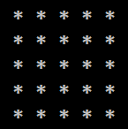
Rectangle of N x N asterisks

Slide 2
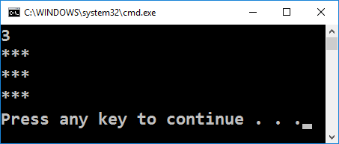
Rectangle of N x N asterisks
Draw a rectangle of N x N asterisks:
int n = int.Parse(Console.ReadLine());
for (var i = 1; i <= n; i++)
{
Console.WriteLine(
new string('*', n));
}
Testing the solution: https://judge.softuni.bg/Contests/Practice/Index/155#1

Slide 3

Rectangle of N x N asterisks
Try it yourself

