Slide 1



Nested Loops

Slide 2
Nested Loops
Nested loops == a loop that contains another loop
The two loops iterate over different variables
Example: outer loop (by row) and inner loop (by col)
The body of the outer loop is repeated n times
for (var row = 1; row <= n; row++)
{
for (var col = 1; col <= n; col++)
Console.Write("*");
Console.WriteLine();
}
The body of the inner loop is repeated n * n times

Slide 3
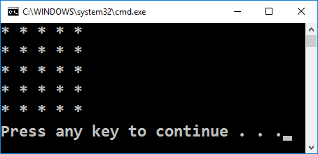
Square of Asterisks
Draw a square of N x N asterisks:
var n = int.Parse(Console.ReadLine());
for (var r = 1; r <= n; r++)
{
Console.Write("*");
for (var c = 1; c < n; c++)
Console.Write(" *");
Console.WriteLine();
}
Testing the solution: https://judge.softuni.bg/Contests/Practice/Index/155#2

Slide 4

Nested Loops
Try it yourself

