Slide 1


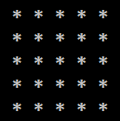
Rhombus of Asterisks

Slide 2
Rhombus of Asterisks
Draw a rhombus of asterisks with size n
n = 3
for (var row = 1; row <= n; row++)
{
for (var col = 1; col <= n-row; col++)
Console.Write(" ");
Console.Write("*");
for (var col = 1; col < row; col++)
Console.Write(" *");
Console.WriteLine();
}
// TODO: print the down side of the rhomb
*
* *
* * *
* *
*
Testing the solution: https://judge.softuni.bg/Contests/Practice/Index/155#5

Slide 3

Rhombus of Asterisks
Try it yourself

