Slide 1
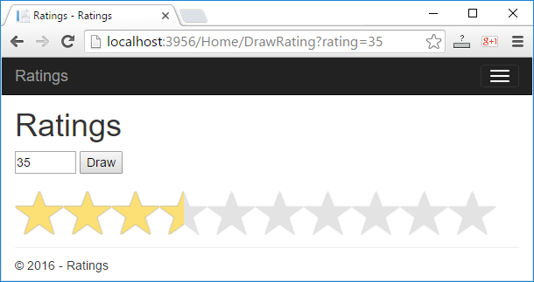
Drawing objects in Web
ASP.NET MVC Application for drawing

Slide 2
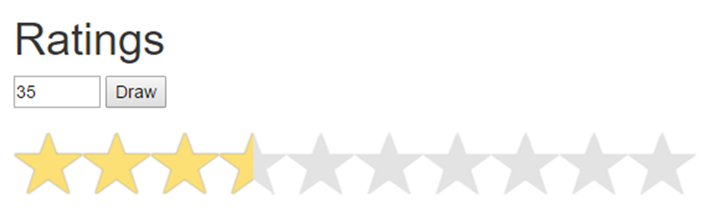
Visualizing rating in Web
Write a ASP.NET MVC web application for visualizing rating (a number from 0 to 100)
Draw 1 to 10 stars (with their halves)
The stars are generated with a for-loop

Slide 3
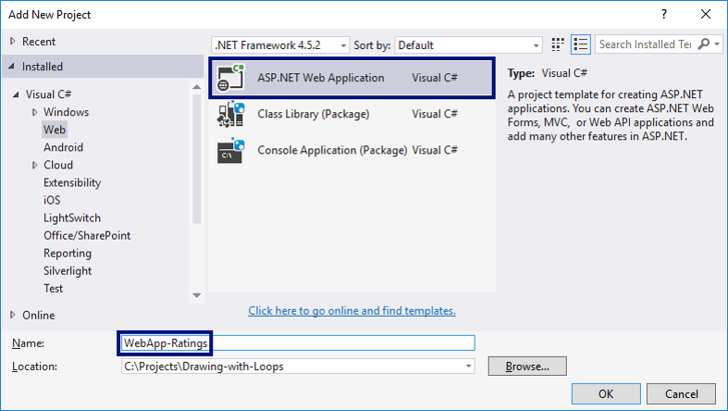
Creating the web application

Slide 4
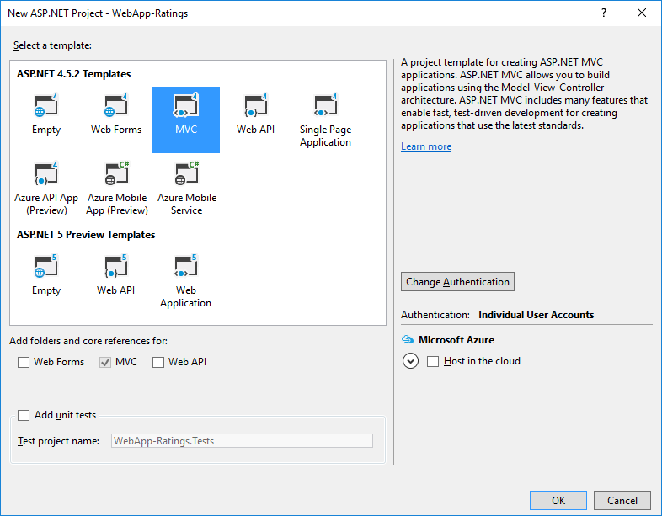
Choosing a web application type: MVC

Slide 5
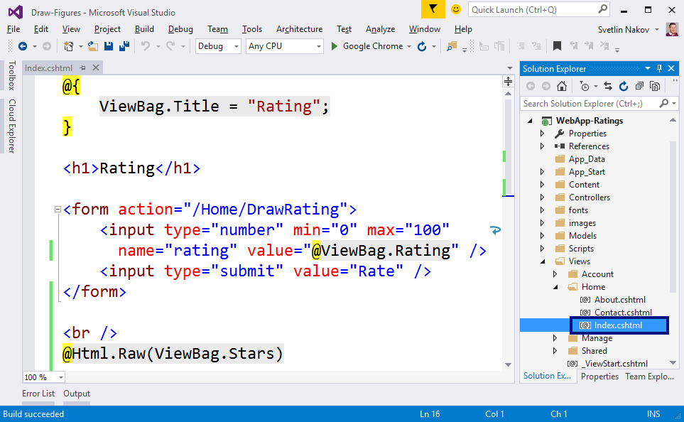
Creating a View

Slide 6
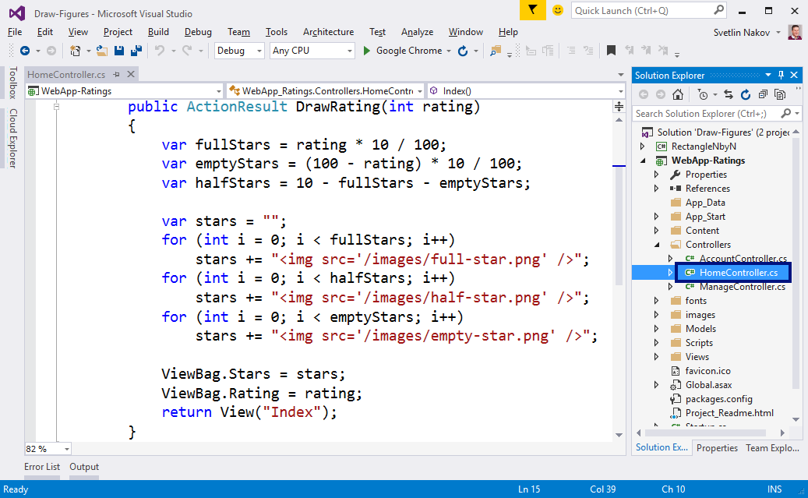
Creating an Action

Slide 7
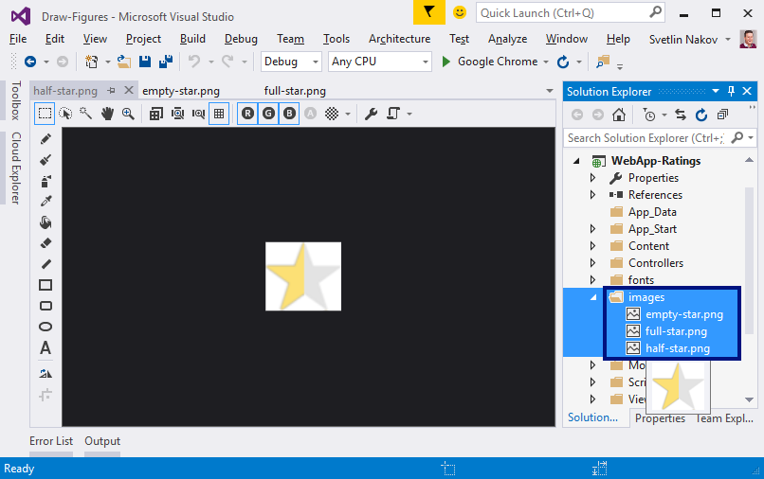
Adding Pictures
Create a folder "images" in the project
Copy the images with stars in it with copy / paste

Slide 8
Start & Test
Start the application with [Ctrl+F5] and test:

Slide 9

Drawing objects in Web
Try it yourself

