Slide 1

What did we learn today?

Slide 2


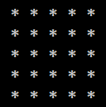
What did we learn today?
We can draw shapes with nested for-loop:
for (var r = 1; r <= 5; r++)
{
Console.Write("*");
for (var c = 1; c < 5; c++)
Console.Write(" *");
Console.WriteLine();
}

Slide 3

What did we learn today?
Do the exercises!

